Slide 1

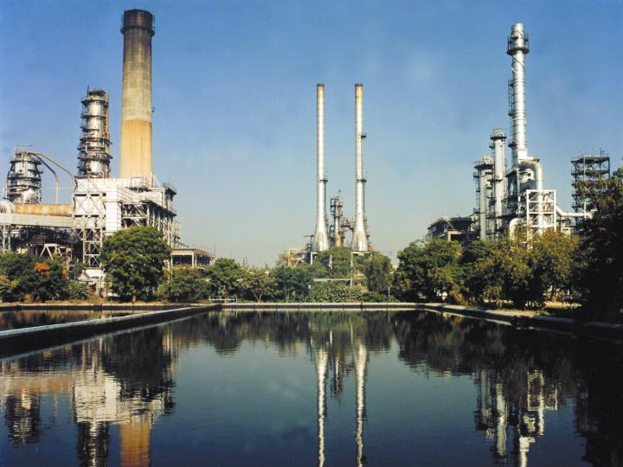
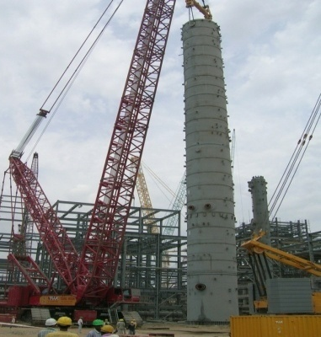
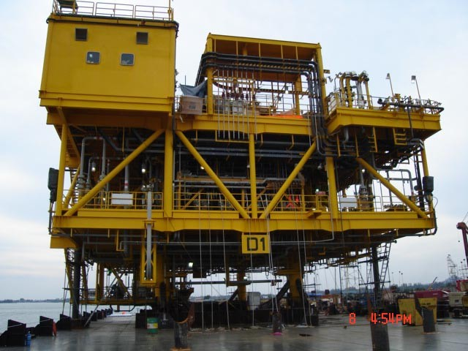
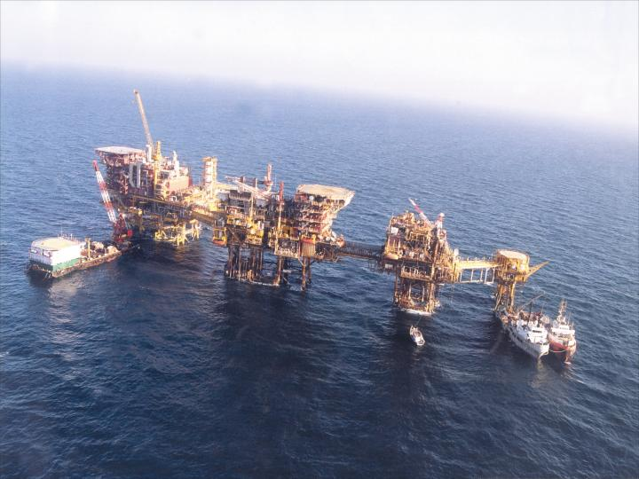
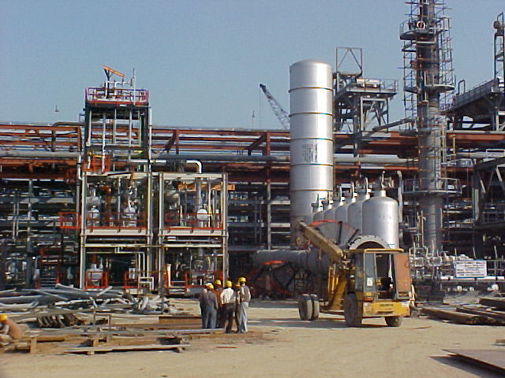
Engineers India Limited
Surface and Underground Coal Gasification
6th Coal Summit, New Delhi
7 Sept. 2016

Slide 2
Outline
Introduction
Coal Gasification
Gasification in India/China
Coal Gasification & Liquefaction Technologies
Multiproduct Generation from Coal Gasification
Underground Coal Gasification (UCG)
Challenges & Opportunities
Conclusions

Slide 3
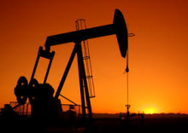
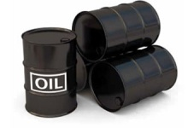
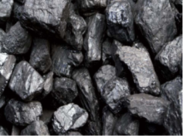
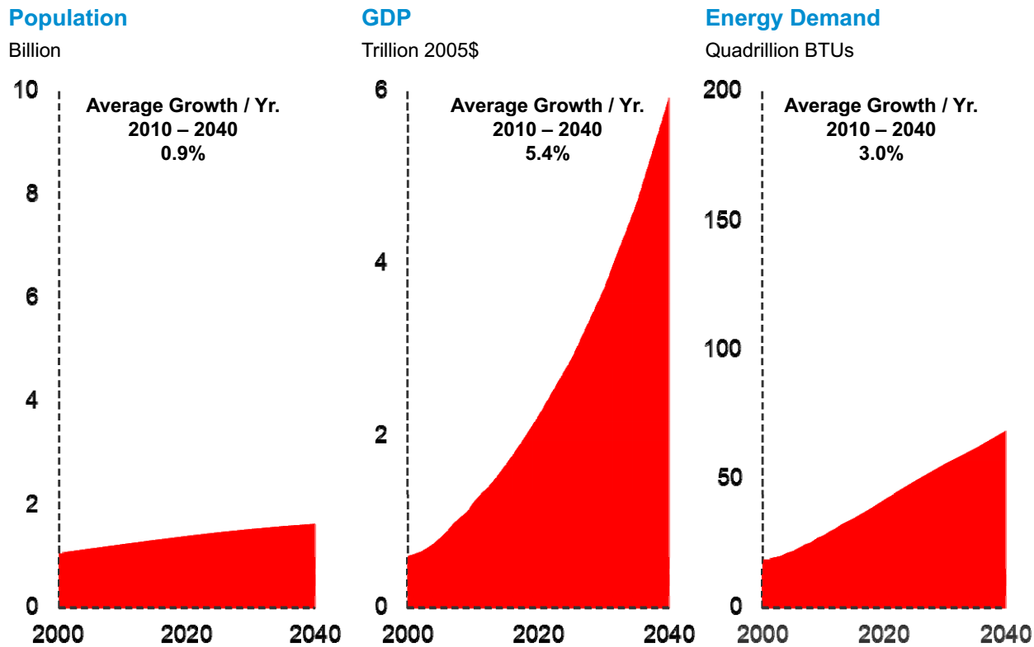
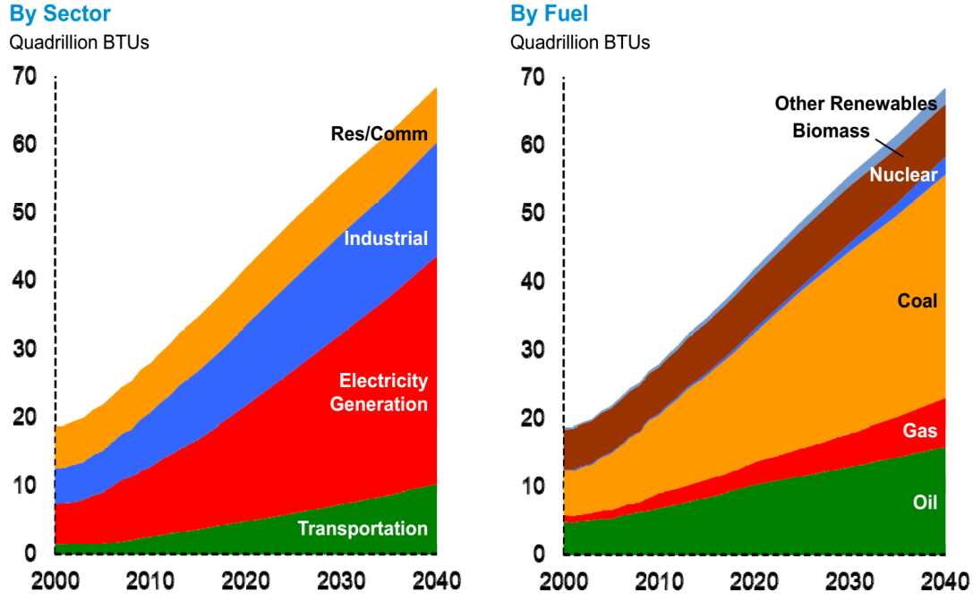
Future Energy Scenario - India
Energy Hungry Nation
(a) Growth Vs Energy Demand Trend
(b) Energy Demand and Supply
India Imports –
77 % of its oil,
30 % of its gas, &
even 34% of Coal
Source: India: Towards Energy Independence 2030
International Oil & Gas Price, Shortage of
Resources are bottlenecks for India’s Economic Growth
Fossil Resource
Starving
Source: ExxonMobil 2014 Outlook for Energy
3
Notes:
Fig (a) : almost linear (y=x) increase in demand can be foreseen, almost 55 % of which substantiated by coal (fig b) due to available supply. (equivalent to almost 35 quadrillion BTU’s out of 65 quadrillion BTU’s)
In India, the picture is different. In a continent that drives demand growth, it is the main contributor. It will likely see an energy intensive ‘industrialization’ phase as the only way to provide enough employment to its vast and growing young labour force. Until 2035, BP forecasts a demand growth of 132% (compared to 71% in China and the non-OECD average of 69%). This is an annual rate of 4.3%, 2.8% above the global rate.
According to BP, fossil fuels, which currently make up 92% of India’s energy mix, will in 2035 still provide 87% of the energy (compared to a global average of 81%). BP forecasts that India will continue to rely, like China, heavily on coal as its dominant fuel. India and China will together account for 87% of the global growth in coal demand and in 2035 account for 64% of total coal demand. Coal will cover 66% of India’s energy requirements and 70% of power generation. (The share of oil will fall, as growth will be driven by power generation for industry rather than the transport sector – part of a global trend.)-
Source - http://www.bridgetoindia.com/blog/indias-energy-future-bps-thoughts-and-ours/
India is the world’s fourth largest economy (adjusted for purchasing power parity) as well as the fourth largest energy consumer. India imports a substantial portion of its energy — 80 per cent of its oil, 18 per cent of its gas, and now even 23 per cent of its coal. As the Indian economy continues to grow, so will its energy consumption, especially as the growth of its manufacturing sector catches up with services and agriculture. With domestic resource production facing various challenges, the general expectation has been that Indian energy imports will continue to grow, and energy security concerns will intensify

Slide 4
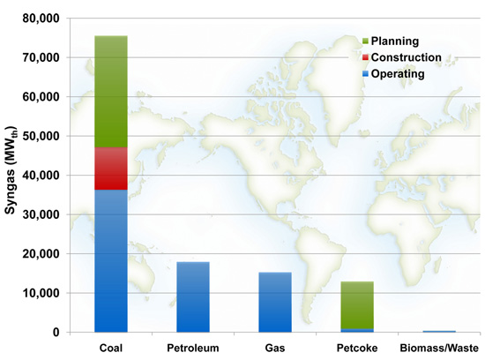
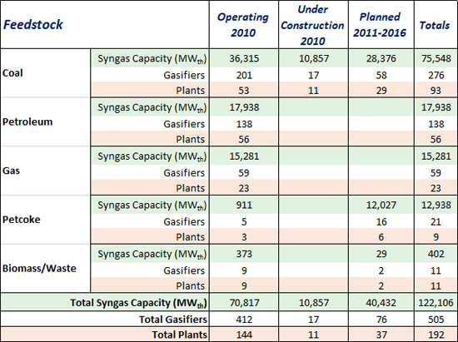
Gasification Feedstock
Coal is at the leading position
Plannned 48 new plants ; 93 gasifiers , 40 are coal based
Plants under construction are mostly coal fired
Planned addition of about 40,000MWth 7-% are coal fed and 30% are based on Petcoke

Slide 5
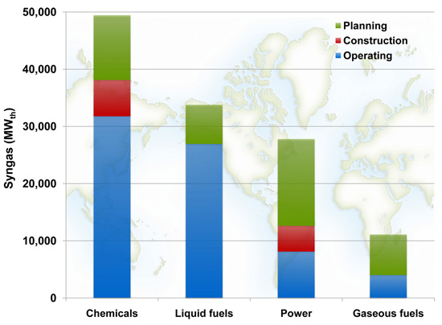
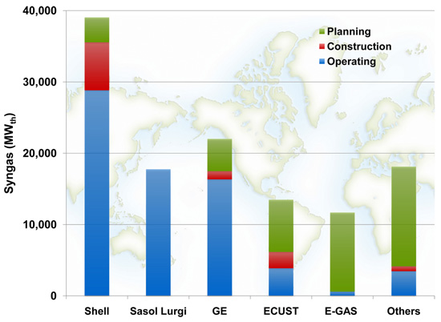
End Destination of Syngas
Chemicals leading position
Plants under operation and construction are based on Shell technology
Once planned capacities are added a larger proportion of plants will be sourced from GE

Slide 6
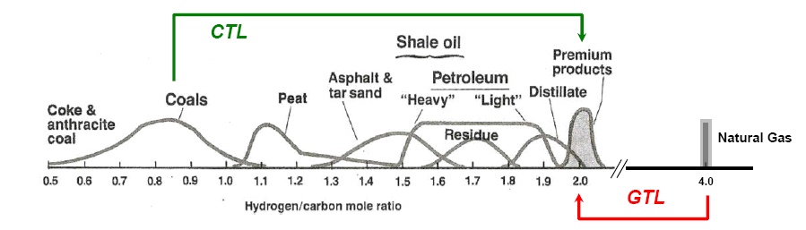
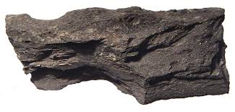
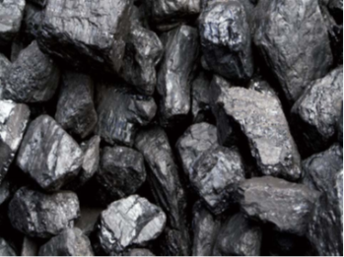


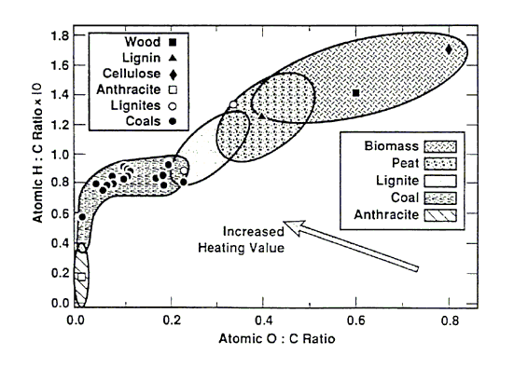
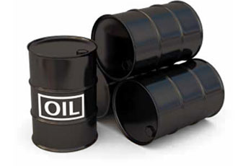
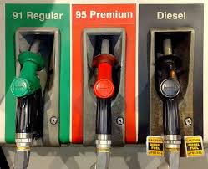
Coal vs. other fuels
SNG
CTL - Add hydrogen or
reject carbon
GTL - Reject hydrogen or
add carbon.
CTG - Add more hydrogen or
reject more carbon.
Volatility
Coal- Low hydrogen, carbon rich source
Notes:
Target of coal liquefaction is to produce substitutes for petroleum distillate fuels having an atomic ratio of 1.8−2.5 more particularly, replacements for gasoline and diesel fuel. To achieve this target, hydrogen is added and/or carbon and oxygen are removed.
Coals, and particularly anthracite, have extremely low hydrogen-to-carbon ratios. The addition of hydrogen to coal results in the transformation of a carbon-rich solid to a liquid fuel with a hydrogen-to-carbon ratio close to 2:1. Methane, which is a gaseous hydrocarbon, has a ratio of 4:1. To make liquid fuels from coal (CTL), it is
necessary to add hydrogen or reject carbon, but to make liquid fuels from natural gas (GTL, gas to liquids), it is necessary to reject hydrogen or add carbon. Coal can also be used to make SNG (substitute natural gas) by adding more hydrogen or rejecting more carbon (CTG).
Rank- The degree of 'metamorphism' or coalification undergone by a coal, as it matures from peat to anthracite, has an important bearing on its physical and chemical properties, & is referred to as the 'rank' of the coal
Low Rank Coal – High moisture, volatiles & less fixed C or carbon energy. Volatile matter decreases as rank increases.
One of the primary underlying issues in the efficient use of abundant hydrocarbon resources is the problem of hydrogen balance. Most desirable from the standpoint of liquid fuels and the chemical industry are medium-length hydrocarbon chains with a hydrogen : carbon atom ratio of ~2 . Methane, the main component of natural gas, has a H:C ratio of 4 and is the primary source of hydrogen gas through steam reforming. In contrast, coal has a C:H ratio of ~ 1 and is either used directly as a fuel or is combined indirectly or directly with hydrogen in coal liquefaction processes to form desirable hydrocarbons. Thus, the efficient large-scale production of chemical and fuel feedstock's is closely tied to the challenge of hydrogen transfer chemistry.

Slide 7
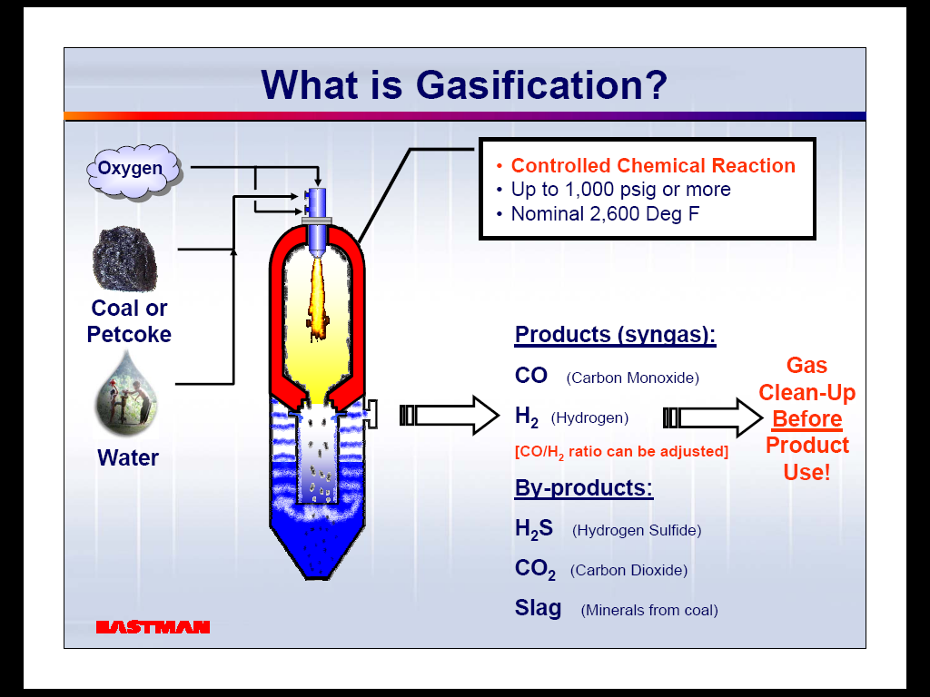
Overview: Coal Gasification
  Basic Overview of gasification
    Carbonaceous material as a fuel (coal, petcoke, biomass etc.)
    Oxidation carefully controlled (1/3 or 1/5 part of O₂ used to that of complete combustion) & coal exposed to steam
    Gasification main steps :
    Devolatilization & Char Gasification
    H₂, CO, CH₄, other products
    Ash/slag leftovers

Slide 8
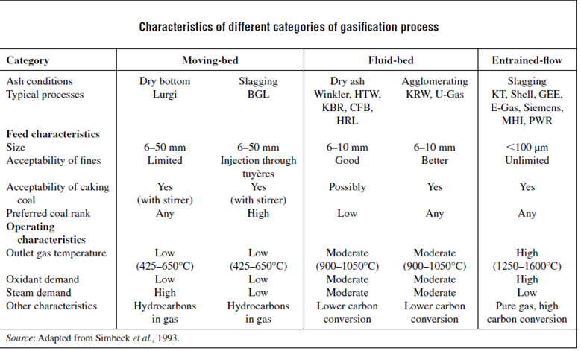
Gasification Technology
Technology selection mainly depends on feed properties :
Ash content
Reactivity
Rank

Slide 9
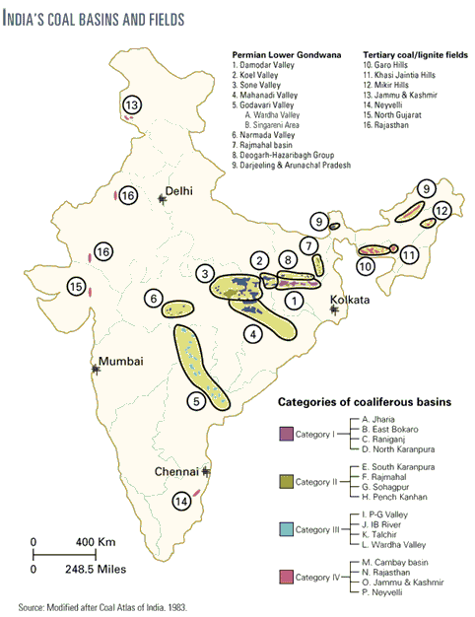
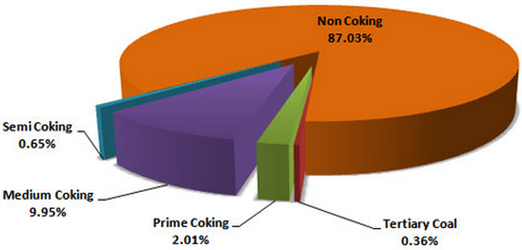
Major Characteristics of Indian Coal
  High Ash & Low Calorific Value- (less energy/ton coal).
  Low Sulphur*
  High Reactivity
  High Ash Fusion Temperature (AFT)
  *Some coal in Assam has high sulphur, low ash (2-10 %).
Distribution of Indian Coal According to Type
Notes:
High Ash Content – upto 50% (refer next slide). High ash content affects in selection of Gasifier and other operational difficulties like ash handling. Ash properties also important.
(Assam Coal - The State is estimated to have about 900 million tonnes of coal reserves. However, coal mining is difficult due to the inhospitable terrains where most of the reserves are located. Suitable for direct liquefaction. ~ about 90 % coal can be directly convertible into fuel. )
Low Calorific Value -
Low Sulfur
Reactivity - Highly reactive coals provide high carbon conversion at moderate gasifier temperatures improving overall system efficiency. The reactivity of coal chars under gasification conditions is a major determinant of the gasifier size and design. Char reactivity has a significant influence on the degree of char recycle and on the volume of oxidant required for the gasifier
High AFT
India alone accounts for 10% of the global coal resources at over 101 billion tons (thermal & coking) of proven reserves, placing her at the third position globally behind the USA and China. At the current rate of consumption it is estimated that it will take more than 200 years to consume the available coal reserves. 83% of the existing coal reserves in India belong to the Non-coking category (grades E, F, G) which is consumed mainly for Power, cement and fertiliser production. India has a total reserve of lignite of 38.76 billion tons, almost 80% of which is found in Neyveli, Tamil Nadu
Primarily, coking coal is low ash and also low sulfur and phosphorus. These impurities would adversely affect steel smelted using the coke. The coking process drives off all of the volatiles in the coal and leaves relatively pure carbon. The heating value is about 25MBtu/ton. Coke is a solid fuel made by heating coal in the absence of air so that the volatile components are driven off.
The coal blocks are concentrated in north east and south east area while major consumers/population is at other locations. This is significant as far as logistics is considered. Preferably CTL plants shall be located near the feed source and coal storage, transportation and conveying in itself is a herculean task.

Slide 10
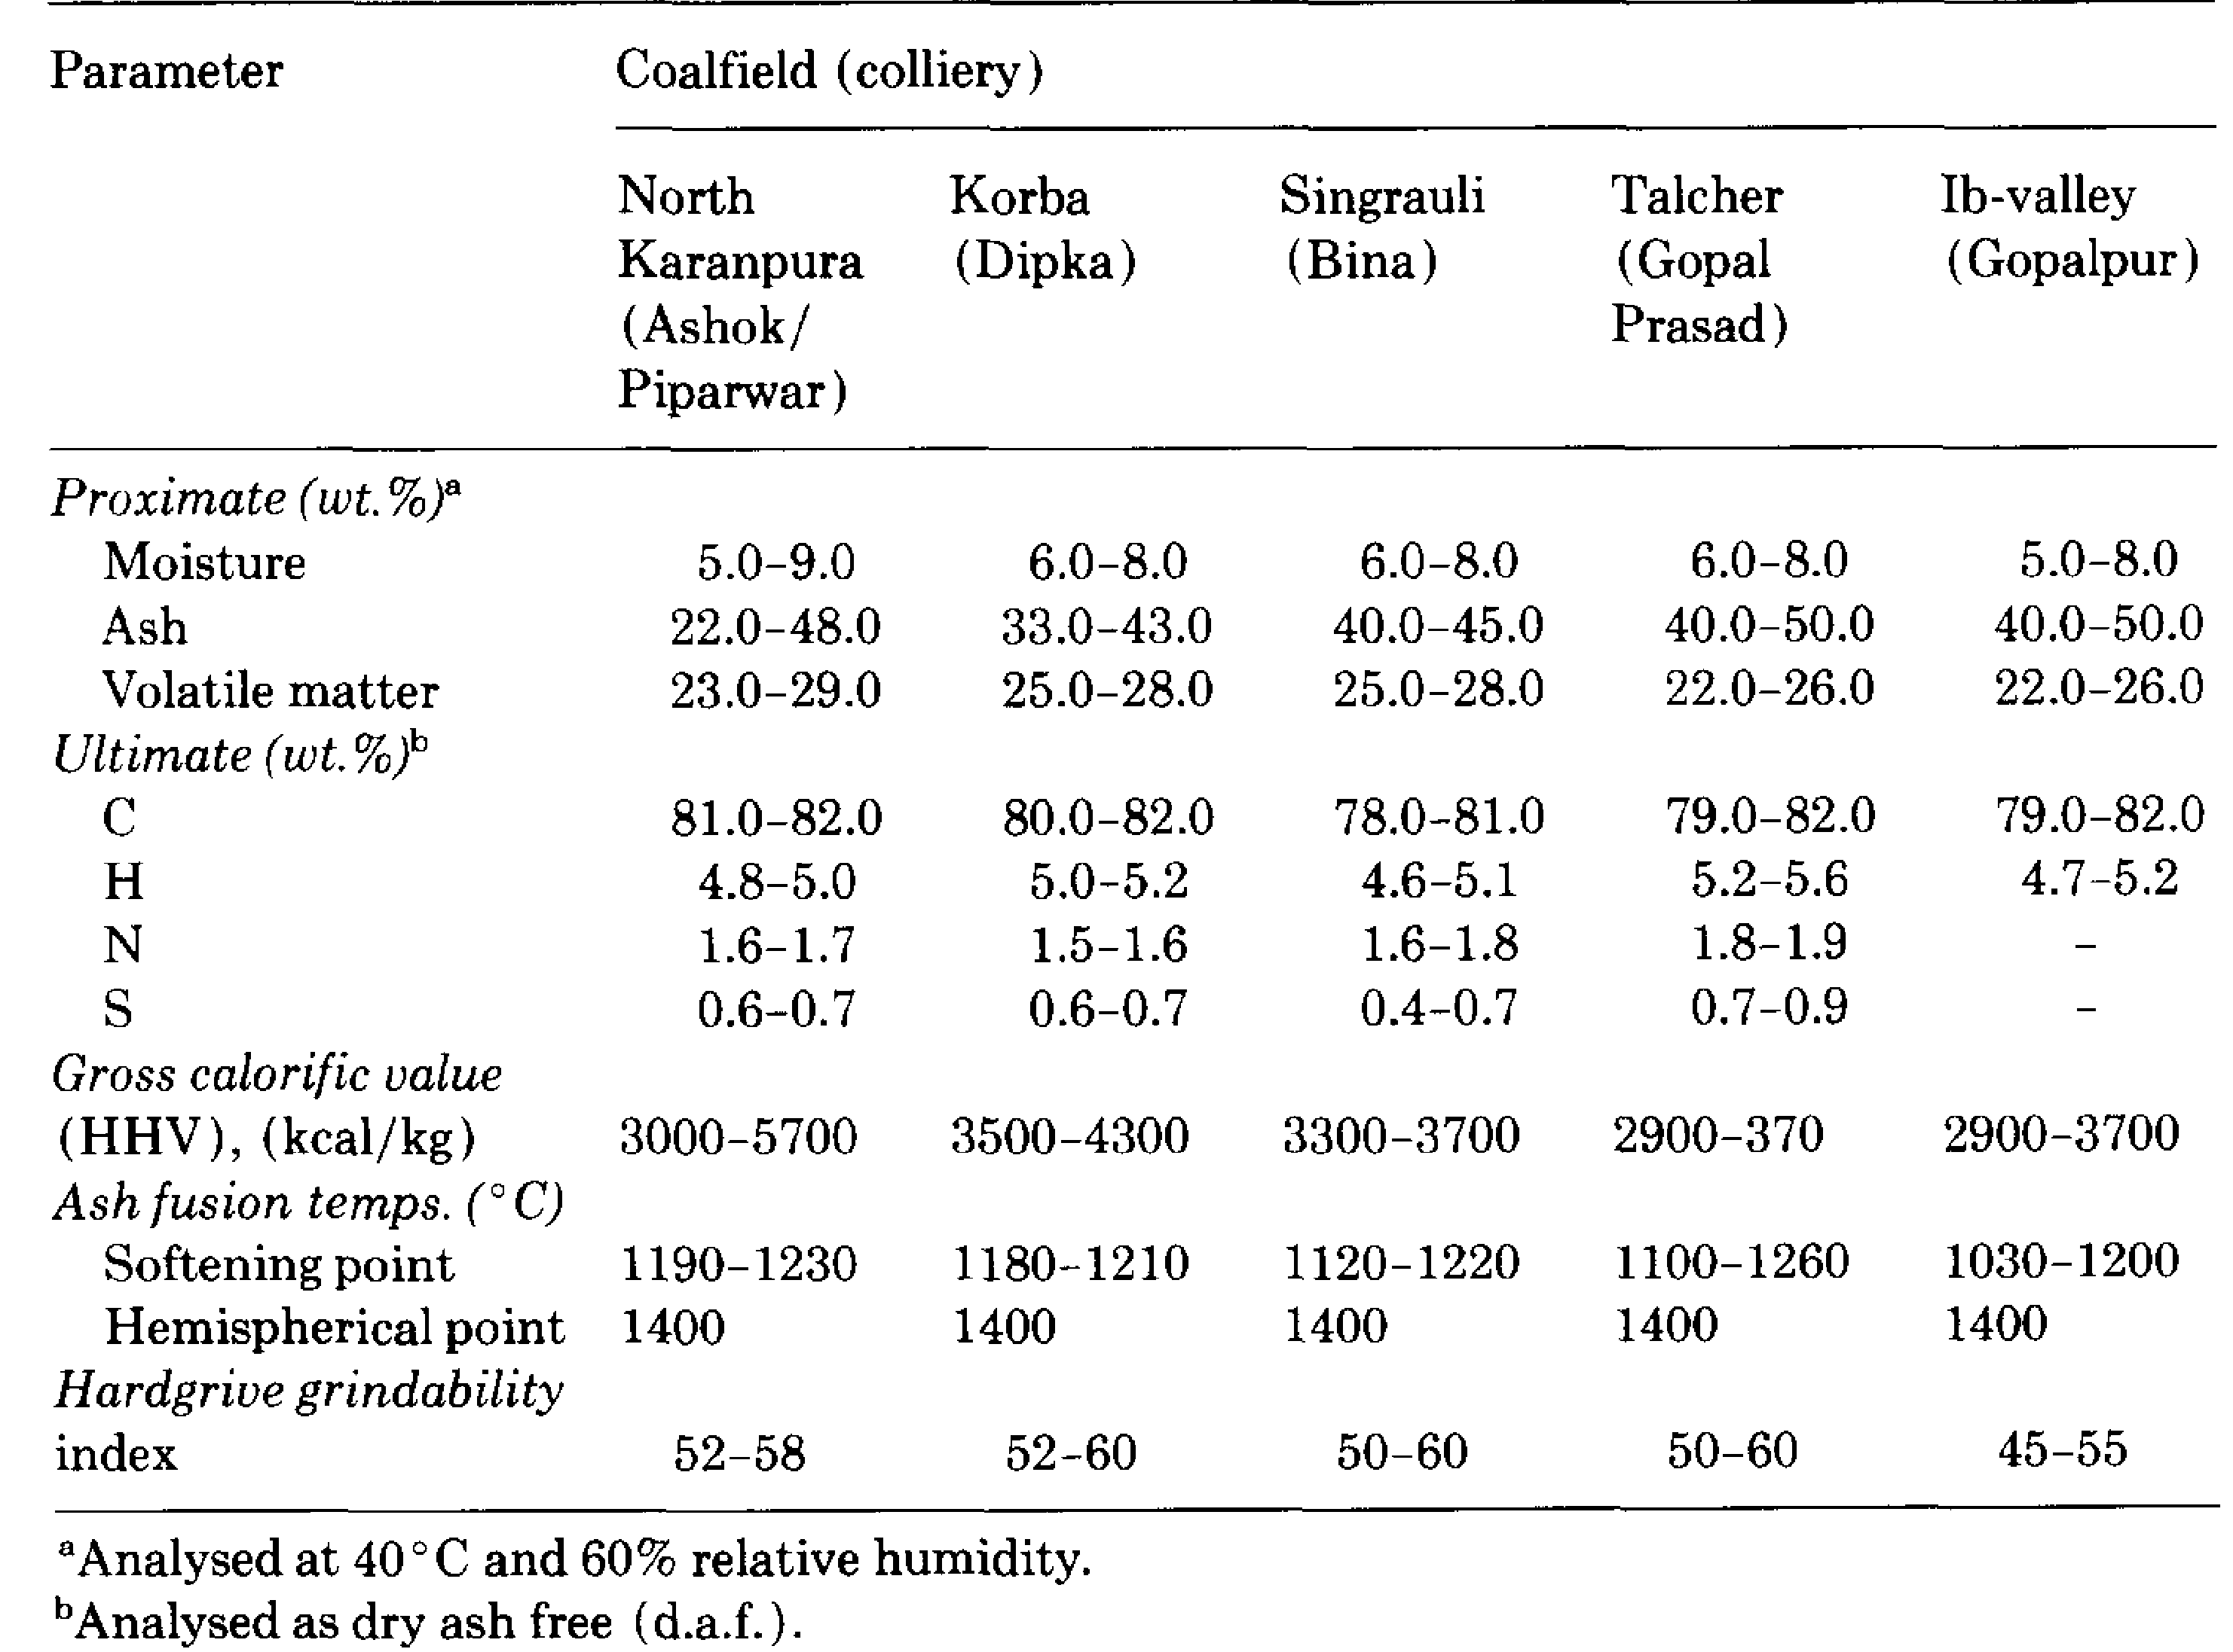
Major Characteristics of Indian Coal - Examples
Ref: Iyengar, R.K. & Haque R. Gasification of high-ash Indian coals for power generation. Fuel Processing Technology, 27 (1991) 247-262
Notes:
Ash can be as high as 50 %. On an avg. approx. 7 % moisture. Only usable coal is 43%. Consequently, less energy per ton of coal is produced. Calorific value of US coal ~4500 Kcal /kg

Slide 11
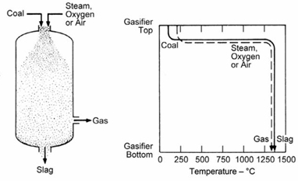
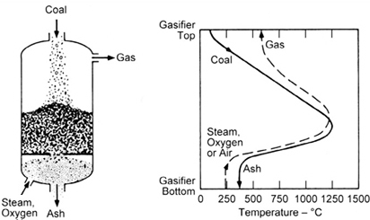
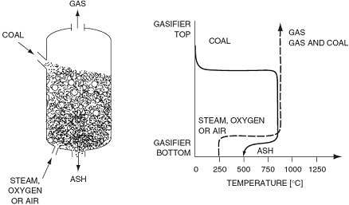

Suitability of Fluidized Bed for Indian Coal
ENTRAINED BED TECHNOLOGY
High ash content with a high melting point - difficulties to all
slagging processes - to be looked non-slagging processes. penetration of slag into refractory line
FIXED BED (MOVING BED) TECHNOLOGY
Byproducts including tar, phenols, ammonia, BTX naphtha etc – marketing on sustained basis.
For high ash coals availability factor of gasifier- spare gasifier needed
Coal washing & or blending of low ash coal is necessary for Indian coal
FLUIDIZED BED GASIFICATION
Provides better mixing, particle- gas contact & heat transfer
Long residence time
High carbon conversion at moderate operating temperature
Little or no tar, oils, phenols & other liquids
Avoids ash agglomeration for high ash fusion temperature
Suitable
Notes:
Entrained Bed – Highest C conversion efficiency, Highest Temperature,

Slide 12
Gasification: Indian Scenario
Plant | Application | Technology | Feed | Capacity | Commissioned | Closed | Remarks
Ramagundam | Fertilizer | Entrained Bed (Koppers-Totzek, Atm. Pressure) Actual Capacity Utilization : 50-65 % | Coal | 3000 TPD | 1980 | 1999 | Ash Content (Design/Actual) 19% Vs 35 (Max 46) Moisture Content (Design/Actual) 8% Vs 15-22%
Talcher | Fertilizer |  | Coal | 3000 TPD | 1980 | 1999
Neyveli | Fertilizer |  | Lignite | 770 TPD | 1969 | 1976 | Major deviation in Lignite Properties
BHEL | IGCC (Power) | Moving Bed (BHEL) | Coal | Pilot |  |  | stopped due to poor performance of the gas cooler and the gasifier was replaced by a fluidised bed
BHEL | IGCC (Power) | Fluidised Bed (BHEL) | Coal | Pilot / Prototype |  |  | Ready for demonstration - 168 t/d air-blown gasifier for Indian Coal
JSPL | DRI | Moving Bed (Lurgi) | Coal |  | 2014
Jindal Synfuels | CTL (Liquid Fuels) |  | Coal |  | Delayed / Abondoned
TATA-SASOL | CTL (Liquid Fuels) |  | Coal |  | Delayed / Abondoned
Kerala State Govt Project, Kochi | IGCC (Power) |  | Petcoke |  | Delayed / Abondoned
Reliance Industries Ltd., Jamnagar | Polygen (H2, SNG,FG, Power, Chemicals) | Entrained Bed CB&I (erstwhile ConocoPhilips) | Petcoke |  | Ongoing
Adani Group | Coal to Poly-generation (CTP) Project |  | Aug 2015 |  | Signed a MoU with the government of Chhattisgarh |  | First Coal to Polygeneration Project
ONGC (Vastan Gujarat) | UCG |  | Pilot |  | Efforts underway
CIL + GAIL + RCF | 3850 MTPD Urea plant, 2700 MTPD Ammonia plant, 850 MTPD Nitric Acid plant, 1000 MTPD Ammonium Nitrate plant. |  |  |  | 2015-16 | start-up expected2019 | Revival of fertilizer complex at Talcher to increase domestic Urea capacity. DFR Completed. Construction activities likely to start
Notes:
No indigenous rigorous efforts in gas cleaning, FT synthesis, methanation & Chemicals from coal

Slide 13
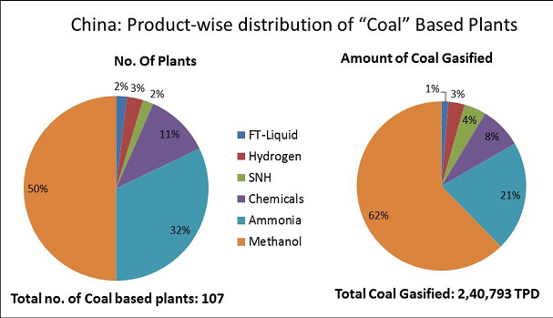
China Gasification- Applications

Slide 14
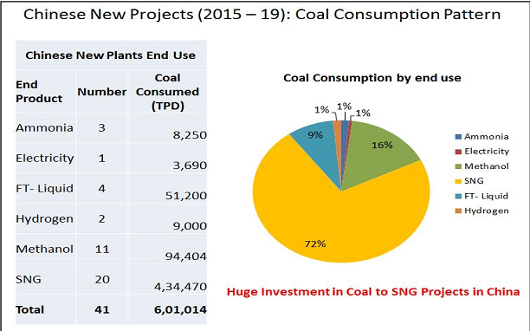
China Coal Gasification Projects - Trend

Slide 15
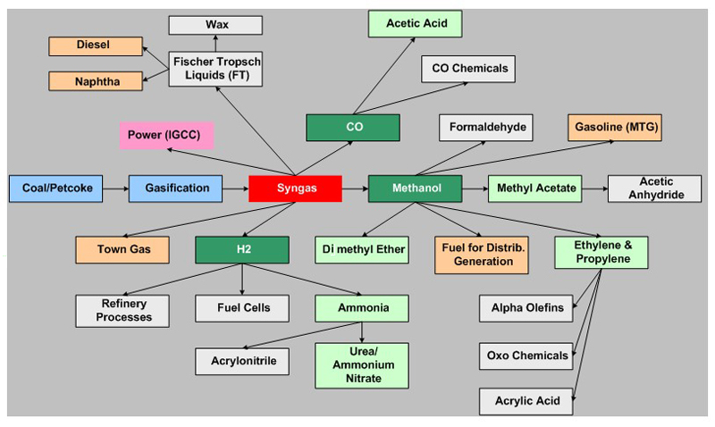
Applications of Coal Gasification
Gasifiers once solved energy problems - they might, yet again.
Notes:
Coal to Liquids, Coal to Electricity and Coal to Chemicals, Coal to Hydrogen

Slide 16
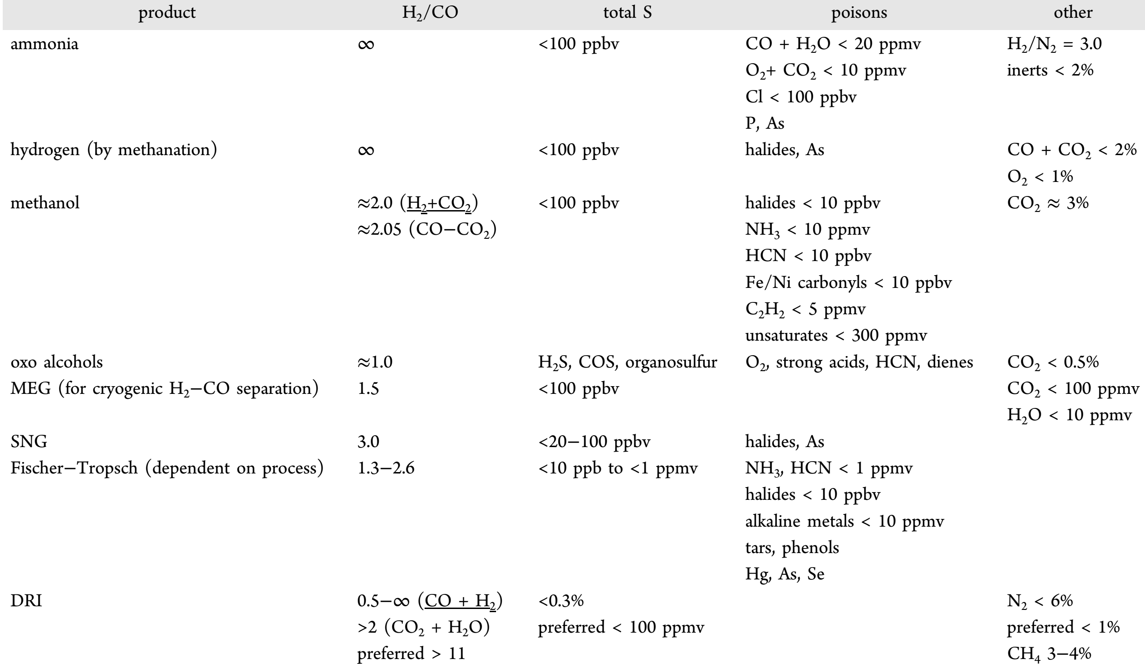
Syngas Cleaning & Conditioning
Syngas treatment and quality are critical

Slide 17
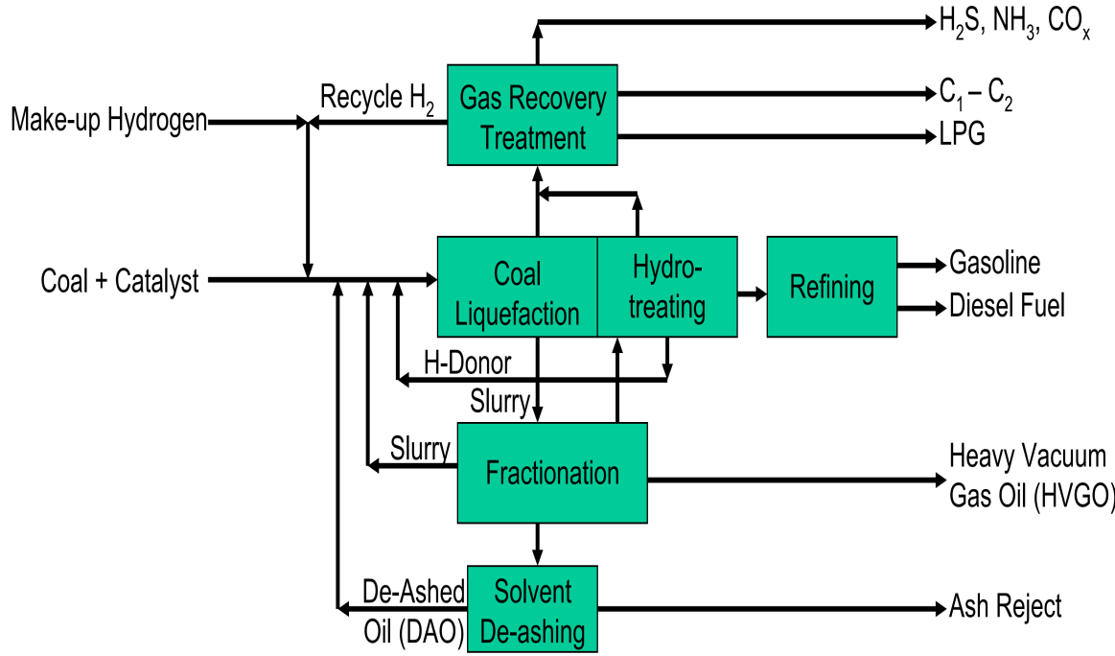
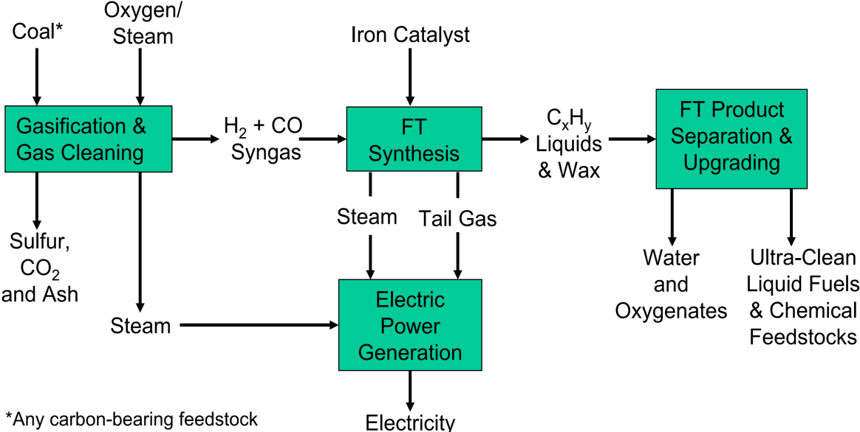
Coal liquefaction technologies for synthetic fuels (1)
Direct coal liquefaction
Indirect coal liquefaction
(example- Fischer Tropsch synthesis)
(Partial dismantling of
coal structure + H₂
addition)
Complete destruction of
ring structure in coal
High efficiency potential
No aromatics, high-octane gasoline, low-cetane diesel
Products w/ higher energy density
Water & air emissions issues
Higher operating expenses
1 Commercial plant at China by Shenhua (~US$1.5 billion)
(~25000 BPD , 3.5 million t/a coal)
Mature & established but complex, less efficient - fewer BTUs per gallon
Low-octane gasoline, ultra-clean diesel
CO₂ capture & power co-production
Use existing refining technologies
Meet all current & projected specifications for sulfur & aromatic
Production capacity >390000 bpd w/ largest operation by Sasol, South Africa
Notes:
Direct liquefaction processes add hydrogen to the hydrogen deficient organic structure of the coal, breaking it down only as far as is necessary to produce distillable liquids.
In Direct Liquefaction (DL) pressure, heat and catalyst are used to crack the coal to make liquids
–theoretical efficiency can be high…roughly 70-75%
–“sledge hammer” approach
•Coal dissolution is accomplished under high temperature (~400 0C) and pressure (~1500-3000 psi) with hydrogen and a coal-derived solvent.
•The coal fragments are further hydrocracked to produce a synthetic crude oil.
•This synthetic crude must then undergo refinery upgrading and hydrotreating to produce acceptable transportation fuels.
In Indirect Liquefaction (IL) coal is first gasified to form syngas. Syngas is then converted to liquids by means of a catalyst and Fischer Tropsch (FT) chemistry
–Synthesis Gas or Syngas –mixture of CO, H2, CO2, H2O
–theoretical efficiency is lower…roughly 60-65%
–“engineered”approach
ICL has Higher (diesel/gasoline) than petroleum derived.
In DCL, the H/C ratio of coal is raised by adding hydrogen. Further hydrocracking of primary coal fragments– Refining of coal liquids
– Products retaining ring structure

Slide 18
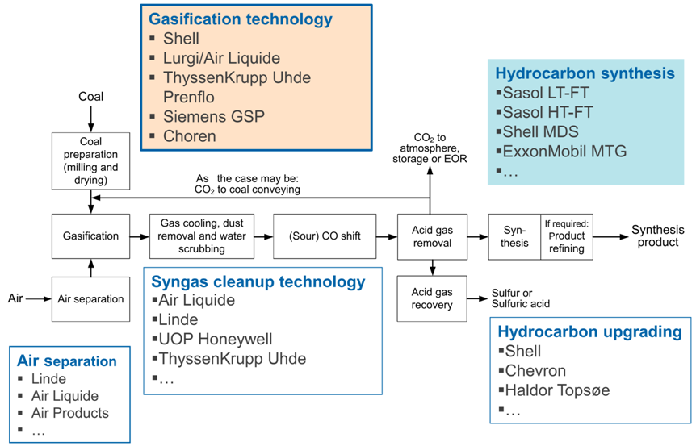
Indirect coal liquefaction

Slide 19
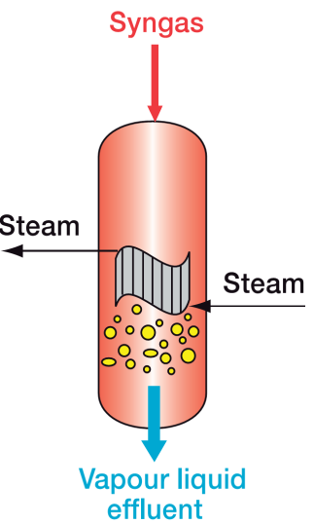
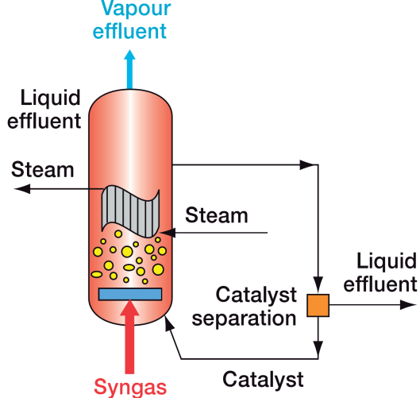
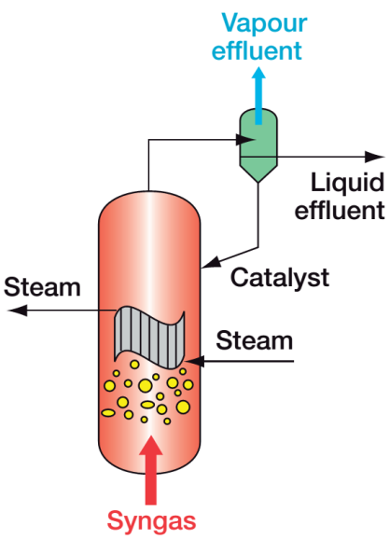


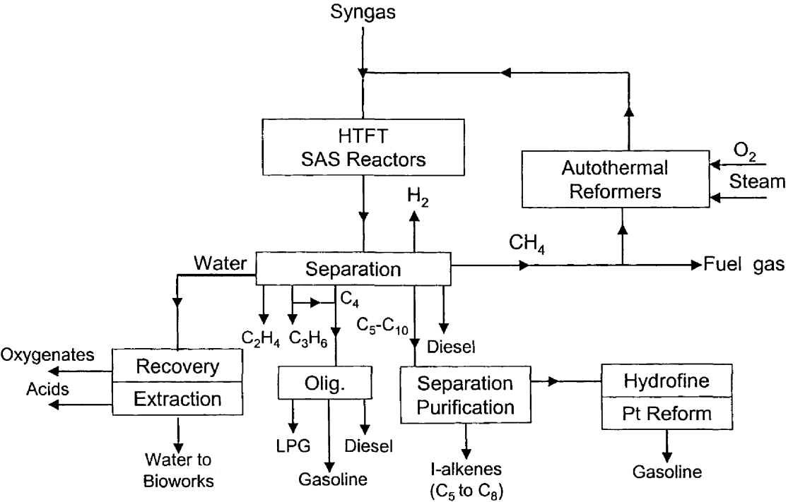
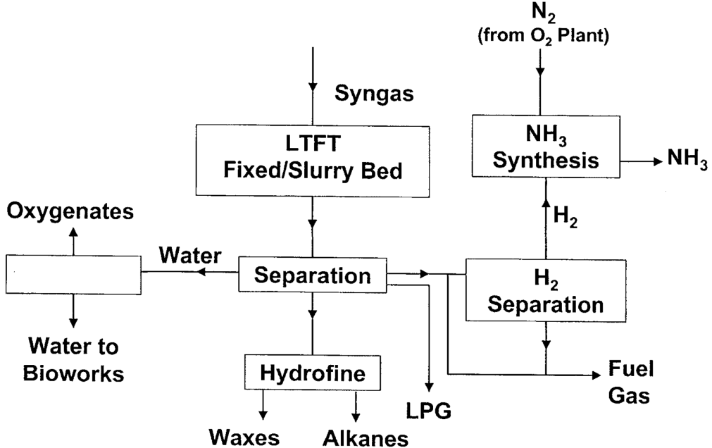
Fischer-Tropsch Synthesis (1) - Technology
LT-FT: 220- 250^{O}C
Cobalt catalyst
(Middle distillates/Waxes)
FIXED SBCR
BED
Shell SMDS Sasol SPD
BP Exxon Mobil
Statoil
Eni/IFP/Axens
Conocophilips
HT-FT: 350^{O}C
Iron catalyst
(Gasoline/Olefins
/ Chemicals)
TECHNOLOGIES
Sasol SAS (FFB)
Sasol Synthol (CFB)
Block Diagram
SASOL SCHEME

Slide 20
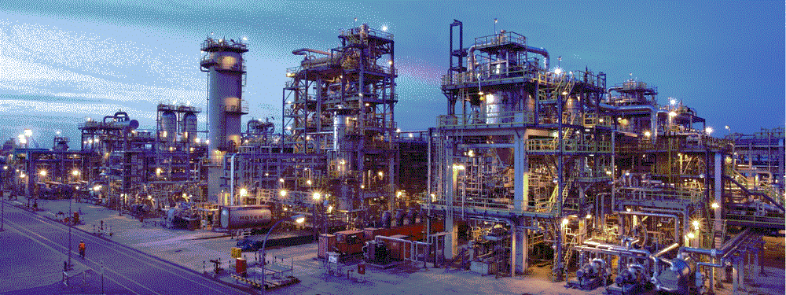
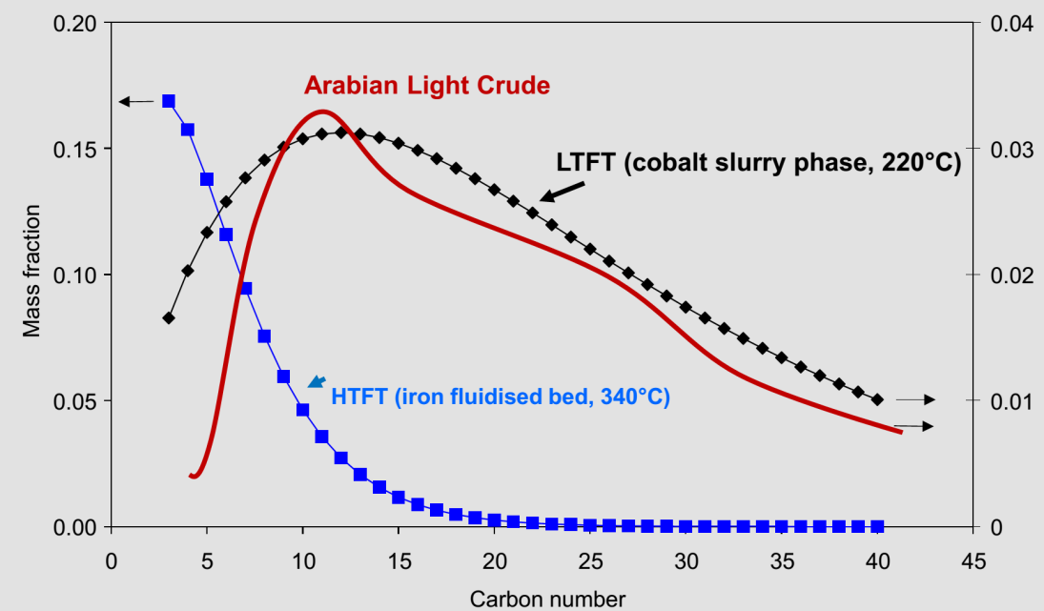
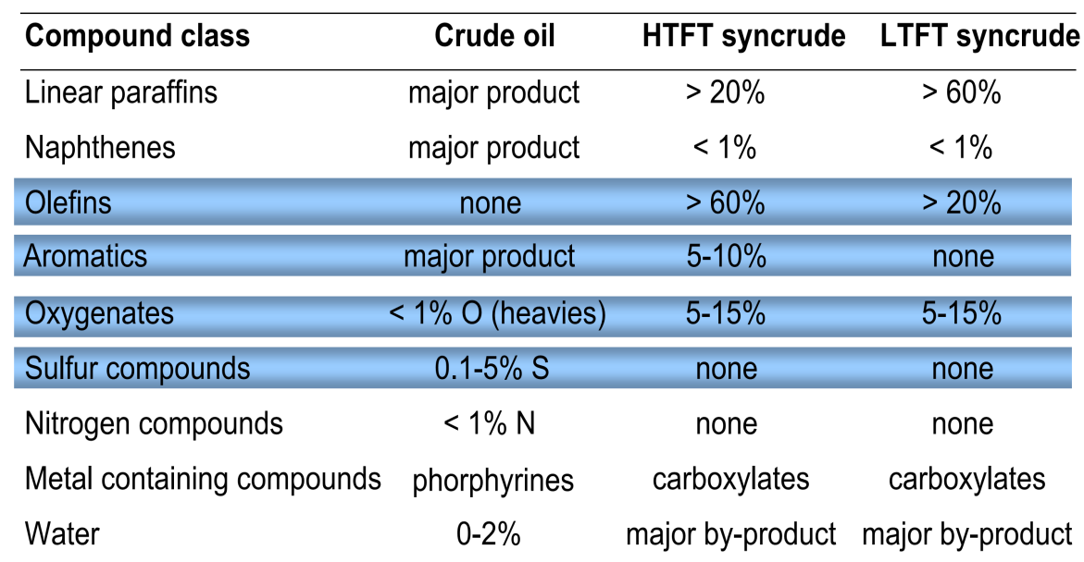
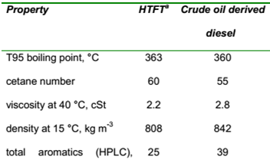
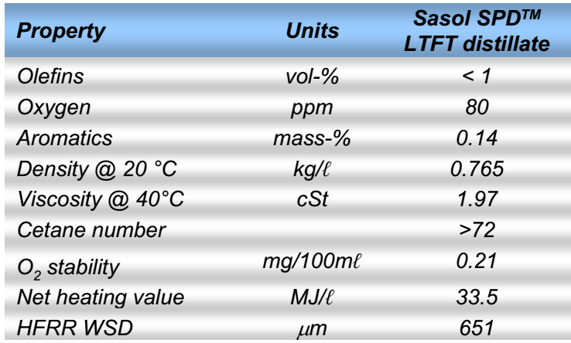
Fischer-Tropsch Synthesis (2)
Distillate Product of HTFT
Distillate Product of LTFT
Notes:
Arabian light crude oil closely matches with LTFT product syncrude. Based on the type of process used the refining scheme may vary.
e.g. Oxygenates high-- ?
Oxygenates low-- ?

Slide 21
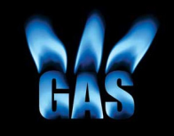
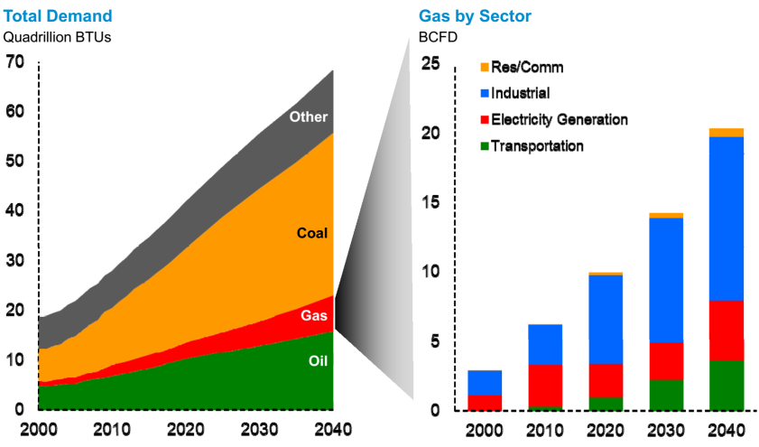
Coal to SNG
India’s Natural
Gas Demand
Natural gas consumption is significant
- Demand outpacing production
- India - fourth largest LNG importer
- Imports expected to rise ~30% in 2015
- National coal reserves is the key
Costly LNG import substitution
- Country’s economic potential
Easy to implement
- Technology well developed
Conventional fuel
- Infrastructure already in place
(Source- ExxonMobil 2014 Outlook for Energy)
MMSCMD | 2012-13 | 2016-17 | 2021-22 | 2026-27 | 2029-30
Domestic sources | 101.1 | 156.7 | 182 | 211 | 230
LNG Imports | 44.6 | 143.0 | 188 | 214 | 214
Gas Imports (Cross-border pipeline) | 0.0 | 0.0 | 30 | 30 | 30
Total | 145.7 | 299.7 | 400 | 454 | 474
Source wise supply of Natural Gas
Expected growth at an average of 6.8% /year
(Source- Vision 2030 Natural Gas Infrastructure in India)
Notes:
demand and price sensitivity studied by Government of India (GoI) (MoPNG) of LNG to meet the immediate demand
average price of NG in the forcible future (2015 onwards) is expected at $ 14 /MMBTU.
It is realized that SNG from High Ash Indian Coal can be produced lower than $14 /MMBTU and can be competitive to RLNG
A coal-to-SNG facility can be built at a coal mine-mouth location, taking advantage of low cost coal. SNG can then be pipelined to local distribution companies and distributed through the existing infrastructure. This approach is used in the Great Plains Coal Gasification Project in Beulah, North Dakota, which employs Lurgi gasifiers followed by shift and methanation steps. SNG has the advantage that it can directly displace natural gas to serve residential, industrial, and utility customers reliably.
Because it is much more efficient to transport a high-quality gas than a moisture and ash-containing solid such as coal, the production of substitute natural gas or SNG may be feasible. However, no other end product of coal gasification has experienced such dramatic market developments within the last decade. Although the shale gas boom in the USA terminated many seriously considered projects, in China, the first wave of coal-based SNG mega-plants went on stream and countries such as South Korea, which have only liquefied natural gas (LNG) imported as an alternative, have projects under construction [Higman]. India is also in similar situation to that of south Korea.
Higman; Advances in Coal Gasification, Hydrogenation, and Gas Treating for the Production of Chemicals and Fuels; Chem. Rev., 2014, 114 (3), pp 1673–1708
For SNG application, coal gasification processes with high methane content (e.g., Lurgi FBDB, BGL, E-Gas) in the product gas have distinct advantages,
that is, savings in gas treatment and compression between gasification and synthesis [Higman].
Higman, C. and van der Burgt, M. (2011) Gasification, Gasification Series, Elsevier Science, Philadelphia, PA
Catalytic Steam Gasification
More efficient than steam gasification
Lower operating temperature (650⁰C-700⁰C)
GreatPoint Energy developed catalytic hydro-methanation process. Expected Pipeline quality SNG price - $3 per MMBtu (Fairley, 2007). Thermal efficiency – 70 -80 %
Catalytic approach utilizes the favourable equilibrium for methane at low temperatures.
Issues- catalyst recovery , reuse. Water (Steam) use
Catalysts- Alkali metal salts of weak acids (like potassium carbonate [K₂CO₃], sodium carbonate [Na₂CO₃], potassium sulfide [K₂S], and sodium sulfide [Na₂S]) can catalyze steam gasification of coal.

Slide 22
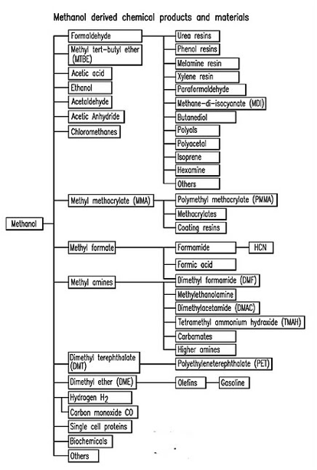
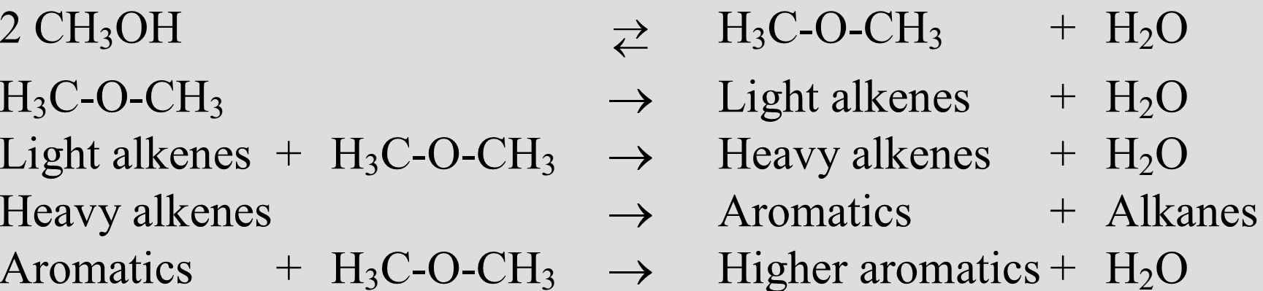
Coal to Chemicals (CTC) - Methanol
Methanol
is starting point for the synthesis of a wide range of industrial Chemicals
- as an alternative fuel
“India imports large amount of methanol (about 80% of domestic demand in 2009),*
ICI low-pressure methanol process
Lurgi two-step reforming
Haldor Topsoe two-step reforming process
MTG (Methanol to Gasoline) Process
*Ref.- Draft National Chemical Policy 2012, Government of India Ministry of Chemicals & Fertilizers Department of Chemicals & Petrochemicals.
Notes:
Carbon monoxide can be used as precursor for acetic acid, phosgene, and formic acid. If hydrogen and carbon monoxide are brought to reaction with olefins, they form aldehydes. The hydrogenation of aldehydes finally yields the oxo-alcohol end product ranging from C3to C18. Such fine chemicals are used as solvents, plasticizers, and detergents and are produced on a scale of a few million tons per year. Pure CO is considered to be>98.5 vol%, whereas oxo-syntheses require H2/CO ratios around unity. Compared to other feedstock, coal-derived syngas may hold the advantage that it is already rich in CO, especially if CO2 is recycled back to the gasifier, that is, as coal-conveying gas.
Ammonia- accounts for about 80% of natural gas consumption as a petrochemical feedstock. Synthesis gas is used in the manufacture of ammonia as a source of hydrogen.
Ammonia is the basis for industrial fertilizer production and, therefore, the most important bulk chemical in the world. About one-quarter comes from coal gasification [Higman]
Methanol- syngas is the main precursor for methanol is the second major user of synthesis gas, where the latter provides both hydrogen and carbon monoxide.
The typical size of methanol plants is between 2000 and 3000 t/d. More than one-third of the total world methanol production was based on coal gasification in 2013. Only 14.3% of total world production of methanol is used directly for blending into gasoline or combustion. The remaining part is converted to derivatives, such as formaldehyde (29.9%), methyl tert-butyl ether (MTBE, 13.2%), olefins (9.1%), acetic acid (8.8%), dimethyl ether (DME, 7.3%), and various other chemical products and gasoline totalling to 17.4%
India’s significant challenges in this field is feedstock availability and prices. Organic chemicals based on ethylene/ propylene, xylene, naphthalene and their derivatives are imported in large quantities due to non-availability of cost competitive feedstock
Oxo chemicals- which are mainly produced by carbonylation reaction of olefins to yield aldehydes that are further hydrogenated to alcohols.
Synthesis gas here acts as source of carbon monoxide.
It should be mentioned here that a special carbonylation reaction of paramount importance in the petro-chemical industry is the carbonylation of methanol to yield acetic acid. This is becoming the most important process for the manufacture of acetic acid
Ethylene/propylene- In near future syngas will probably soon be the main source for ethylene too

Slide 23
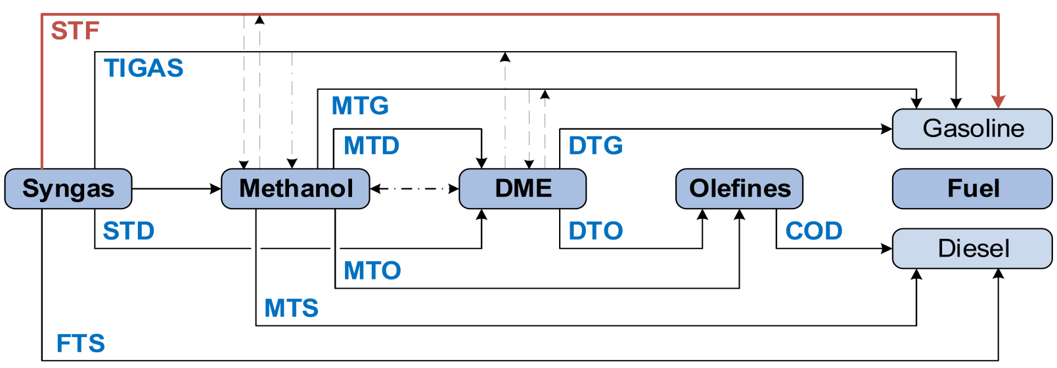
Methanol-based fuel production
TIGAS Topsøe Integrated Gasoline Synthesis
MtG Methanol-to –Gasoline e.g.. ExxonMobil (Uhde)
DtG Dimethyl ether-to-Gasoline (e.g.. Karlsruhe Institut fürTechnology)
DtO Dimethyl ether-to -Olefins (e.g.. Karlsruhe Institut für Technology)
MtO Methanol-to -Olefins (e.g.. UOP, MtP by Lurgi/ Air Liquide)
StF Syngas -to -Fuel (CAC, TU Freiberg)
MtD Methanol-to -Dimethyl ether (eg. Lurgi/ Air Liquide)
StD Syngas -to -Dimethyl ether (eg JFE)
COD Conversion of Olefins to Distillates (e.g. Lurgi/ Air Liquide)
MtS MtSynfuels ® by Lurgi/ Air Liquide

Slide 24



Coal to Chemical (CTC) – DME
DME as LPG Substitute
Burns like Natural Gas
Wobbe Index 52 (Natural gas 54)
Boiling point -25°C (Propane -42)
Vapour pressure 0.53 MPa (Propane 0.91)
Handles like LPG
Completely miscible in LPG
Existing LPG infrastructure - Below 20 % DME.
For neat DME, minor changes in sealing materials and burner tip.
Same efficiency and emission as LPG from cooking stove to industrial boiler.
Outstanding Diesel Alternative
Clean-burning alternative to diesel Cetane number 55-60 (Gas oil 40-55)
No smoke, no sulphur
NOx : ~ 90% reduction
CO2 : ~ 95% reduction
Cost – Relatively moderate
(with very high conversion efficiency)
Energy density
Lower than diesel (must be pressurized to be used in modified diesel engines)
Significant interest in this diesel substitute in Japan and other parts of Asia.
Methane DME Propane
Today,150,000 t/y as aerosol propellant, plus 300,000 t/y for emerging fuel market
Notes:
1) The Wobbe Index (WI) is an indicator of the interchangeability of fuel gases such as natural gas, LPG, and town gas and is frequently defined in the specifications of gas supply and transport utilities.
2) Fuel DME product Co. (Japan) has constructed 80 Kt/y commercial plant at Niigata Japan, supplying Fuel DME
DME contains an oxygen atom, the gas phase heat of combustion, -1,460 kJ/mole, is less than propane, -2,219 kJ/mole, so a greater quantity must be burned to generate the same amount of heat

Slide 25

Coal to Chemical (CTC) - Ammonia
Commercial technology
• Johnson Matthey
• Linde
• Kellogg Brown and Root
• Haldor Topsøe
• Ammonia Casale
• Uhde
92 % of Ammonia in China is produced through Coal against 0 % in India
World ammonia production by feedstock type. Source: IFA, 2010b
Global demand for ammonia, exceeded 170 million metric tonnes in 2013………IHS report
 | NG | Naphtha | Fuel Oil | Coal
Relative investment | 1.0 | 1.15 | 1.5 | 2.5
Relative sp. Energy requirement (based on LHV) | 1.0 | 1.1 | 1.3 | 1.7
Relative ammonia plant investment and relative energy requirement for 1800 t/d NH₃
Notes:
- a key component in fertilizer and agricultural products essential to expanding food crop production.

Slide 26
Underground Coal Gasification
“in-situ” conversion of coal into combustible gases.
Drilling requirement –
Injection/Production wells (Vertical) & Well linking (Horizontal)
Reactant materials –
Air or Mixture of air/steam & High temperature and pressure & Ignition
Products–
Combustible Gas: CO, CO₂, CH₄, H₂ & Others: H₂O, char, H₂S, tars, etc.
Further processing
Gas clean-up & Power generation/ Chemical synthesis
Successful UCG can provide a low to medium heating gas (80-250 kJ/mol) – for air/oxygen blown plants

Slide 27

Underground Coal Gasification - Keep the design intent, but move the
Gasifier underground
Advantages
Possibility of 300 – 400 % increase in resource utilization
No Labour under dangerous conditions underground
No significant surface impact
Direct use of Synthesis gas with 50 % Less particulate emission and easier capture of NO_{x} and SO_{x}
Cheap and easy remediation of site post utilization along with effective coal utilization
Concerns
Managing ground water resources and preventing subsidence
Establish agile and modular facilities to ensure continuous end use of gas
Non steady state process – Can’t be controlled as efficiently as surface gasification
If 5% of India’s non-mineable coal reserves are successfully utilized for gasification, it could yield three-trillion cubic metres of gas equivalent.
(Mining Weekly, 2013)

Slide 28
UCG Trials - Status
Summary of UCG field trials with coal type & thickness
Location | Coal type | Thickness (m) | Depth (m) | Year | Comment
Lisichanskaya | Bituminous | 0.44–2 | 60–250 | 1948–1965 | Discontinued due to thin seam
Yuzhno-Abinskaya | Bituminous | 2.2–9 | 50–300 | 1999–current | Used for heating
Angrensikaya | Lignite | 2–22 | 120–250 | 1957–current | Used for power generation
Podmoskovnaya | Lignite | 2.5 | 30–80 | 1946–1953 | Coal exhausted in 1953
Shatskaya | Lignite | 2.6–4 | 30–60 | 1963–1956 | Abandoned due to technical problems
Sinelnikovsky | Lignite | 3.6–6 | 80 | – | -
Chinchilla (Australia) | - | 8–10 | 130 | 1999–2004 | UCG-IGCC and multiple wells
France | Anthracite | – | 1200 | 1981–1986 | Well link by combustion and hydrofracture were unsuccessful
Belgium | Anthracite | – | 860 | 1979–1987 | Difficulties in completing gasifying circuit
Newman (UK) | Subbituminious | 0.75 | 75 | 1959 | Four bore holes of 140 m and diameter 0.3 m
Tremedal (UK) | Sub-bituminous | 2-5 | 530-580 | 1989-1998 | -

Slide 29
Properties of Coal gasified in UCG Trials
Country | Location | Proximate Analysis (wt %) |  |  | Ultimate Analysis (%) |  |  |  |  |  | Heat value (kcal/kg)
 |  | M | Ash | VM | FC | C | H | O | N | S
US | Blue greek seam | - | 6.79 | 36.15 | 57.06 | 76.5 | 5 | 8.64 | 1.71 | 0.7 | 13992
 | Hanna no.2 | – | 26.26 | 36.07 | 37.67 | 54.81 | 4.45 | 12.3 | 1.43 | 0.75 | 9580
 | Flix no.2(3) | – | 5.8 | 45.96 | 48.24 | 69.23 | 5.24 | 17.8 | 1.45 | 0.49 | 11960
 | G-win | – | 15.41 | 20.63 | 63.96 | 74.67 | 4.25 | 3.38 | 1.11 | 1.18 | 13323
 | Flix -no.2(1) | 29.2 | 6.37 | 31.9 | 32.9 | 47.41 | 3.53 | 12 | 0.91 | 0.02 | –
France | – | 1.4 | 3.4 | 28.6 | – | 80.13 | 4.71 | 6.27 | 1.47 | 0.63 | 78.65
China | – | 4.18 | 7.61 | 23.08 | – | 72.72 | 4.71 | 8.32 | 1.13 | 1.33 | 28.14–29.31 MJ/kg
 |  | 0.02–0.18 | 16.15–19.50 | 28.68–30.01 | 31.71–53.74 | – | – | – | – | – | –
UK | Newman Spinney | 6 | 6 | 35 | 53 | – | – | – | – | – | –
Spain | Tremendal | 22.2 | 14.3 | 27.5 | 36 | – | – | – | – | – | 18.1 MJ/kg
Australia | Chinchilla | 6.8 | 19.3 | 40 | 33.9 | – | – | – | – | – | –
USSR and Russia | Lisichanskaya | 12–15 | 7–17 | 39–40 | – | – | – | – |  |  | 20–23
 | Yuzhno-Abinskaya | 2.5–8 | 2.3–5.2 | 27–32 | – | – | – | – | – | – | 28–30
 | Angrensikaya | 35 |  | 33 | – | – | – | – | – | – | 15.1
 | Podmoskovnaya | 30 | 34.3 | 44.5 | – | – | – | – | – | – | 11.8
 | Shatskaya | 30 | 26 | 38.1 | – | – | – | – | – | – | 11.1
 | Sinelnikovsky | 55 | 23.8 | 64.5 | – | – | – | – | – | – | 8
Notes:
These sites have the following parameters which are important for UCG:
Depth 30–580 m,
Thickness 2–5 m,
Ash 2–34%,
Moisture 7–35%,
Volatile Matter 27–44% and
Fixed Carbon 12–38%.
Mines which fall in these categories can be ideally suited for UCG.

Slide 30
Preferred UCG sites
These sites have the following parameters which are important for UCG:
Depth 30–580 m,
Thickness 2–5 m,
Ash 2–34%,
Moisture 7–35%,
Volatile Matter 27–44% and
Fixed Carbon 12–38%.
Mines which fall in these categories can be suited for UCG.

Slide 31
Brief Comparison: Surface & UCG
Surface
UCG
Mining, transport, handling and treatment required – Labour & energy intensive (additional OPEX for pre treatment of coal)
Cogeneration and flexibility in feedstock possible in the absence of coal – Facility for processing is common
Requires handling of Ash and pre-treatment of coal – Ash disposal issues
Better Control
Requires a Gasifier - CAPEX
Coal is used directly at the point of availability – Transport & logistics issues can be addressed
Only one fuel – Coal – Only cost – drilling, linking and gas handling – No feedstock flexibility
No need of pre-treatment of coal - Ash effects can be ignored
More Unknown and difficult to control –efficiency and control of operation are Limited
The seam surrounded by over and under burden is the gasifier – Issues like finding suitable location considering aquifer contamination issues, right mix of seam depth and thickness

Slide 32


Challenges & Opportunities
Access, source, market need, location for a project, energy security
Complex and high investment projects
High cost of new technology, future with CO2 fixation and CCS
Need to strengthen the R&D environment
High Investments linked to price volatility, high risk
Need collaborative approach , partnerships
Policies in place to give impetus to clean coal technologies
Notes:
As a solid material of differing quality, it is the most challenging fossil energy carrier regarding production and handling compared to petroleum or natural gas - for a specific product, the capital investment is in general very high for the coal-based version
In addition to typical ballast materials, such as ash or water, coal incorporates varying quantities of oxygen, which can be considered as an already burned” portion of the organic matter not contributing to the energy yield. Consequently, a certain amount of energy or product produced from coal is always linked to lower efficiency and also higher specific CO2 emissions compared to other feed-stock without moisture, ash, and oxygen ballast. Therefore, considerable efforts are necessary to bring coal to a low level of CO2 emissions
Another challenge, especially for hydrocarbon products, is the lack of hydrogen in the coal expressed in a low molar H/C ratio
Access to technology & stronger national/ international partnerships needed
■ Complex projects High cost of new technology Need to strengthen research environment Expensive & high risk investment for any single industry player Need collaborations with emerging technology providers
■ Needs strong support from Indian Government Need Public/ Private partnerships and partnership with technologically advanced players
In addition to having spare gasifiers, one strategy to overcome this problem is polygeneration, that is, production of two or more products, out of
which at least one can be stored. More than one gasifier can be used to guarantee the production of one persistently required product (e.g., hydrogen, power), while another portion of the syngas is converted into a product that can be stored in a buffer (e.g., ammonia, methanol, even SNG in a grid). Hence, downtime of a single gasifier does not interfere with the persistently required product

Slide 33
Gasifier Pilot Plant at EIL (FB Type)
A coal gasification fluidized bed plant is designed and installed at EIL-R&D center
Capacity: 150 kg/h (High Ash Indian Coal)
O2 purity: 93% by volume
The plant consists of
  Coal crushing & feeding system
  High pressure gasifier with ash removal system
  Cyclones
  Syngas cooling systems
  Ash disposal system
  Air separation unit, etc.

Slide 34



Gasifier Pilot Plant
Capacity: 350 Nm3/h
Operating pressure: 30 bar
Capacity: 150 Kg/h HAIC
Operating pressure: 30 bar
SYNGAS FLAME IN BLUE
GASIFIER PILOT PLANT
SYNGAS CLEANING PILOT PLANT

Slide 35
Conclusions
For a developing country like ours, in absence of other major fossil fuels, considering overall energy options in India; utilizing coal for energy, remains quintessential.
Energy Security - India’s growing dependence on energy imports increases uncertainty regarding availability of energy at affordable prices.
Environmentally responsible gasification technologies are helping to unlock the India’s coal reserves with increasing effciency.
UCG can potentially access coal resources that are not mineable conventionally or not-economical to extract
- Potential to more than double recoverable coal resources
- UCG is an in-country energy solution, independent of exchange rate and oil price
Economics, government policies and geo-political, global energy scenario are the key decisive factors and remain as a key issues.
Notes:
China -The synthesis gas (syngas) produced is being used in chemical and integrated gasification combined-cycle (IGCC) plants worldwide. China, in particular, has embraced coal gasification technology as a way of using its abundant, indigenous coal reserves efficiently and with low environmental impact to manufacture methanol, ammonia, hydrogen, and synthetic liquid hydrocarbons.
Energy Security - How do we deal with this supply risk? The threat to energy security arises not just from the uncertainty of availability and price of imported energy, but also from the possible disruption or shortfalls in domestic production. Supply risk from domestic sources, such as from a strike in Coal India or Railways, also needs to be addressed. Even if there is no disruption of supply there can be the market risk of a sudden increase in oil price. Again, even when the country has adequate energy resources, technical failures may disrupt the supply of energy to some people. Generators fail, transmission lines trip or oil pipeline may spring a leak. One needs to provide security against such technical risks. Risks can be reduced by reducing the requirement of energy by increasing efficiency in production and use of energy; by substituting imported fuels by domestic fuels; by diversifying fuel choices (gas, ethanol, orimulsion tar sands etc.) and supply sources;

Slide 36

THANK YOU

Slide 37
Backup

Slide 38


Economics - Commercial attractiveness of products from coal gasification technology
Source - Morehead, H. (2013) Siemens gasification: progress and innovation. Proceedings of the Gasification Technologies Conference, October 13–16, 2013, Colorado Springs,. www.gasification.org
Notes:
It can be clearly seen that ammonia is by far the most attractive product followed by gasoline, methanol, and its derivate polypropylene. The price of synthetic natural gas (SNG) is strongly dependent on the competing source of natural gas. Of course, this is only an indication of product value, and the main question remains as to what cost the product can be produced through coal gasification. Therefore, specific boundary conditions (e.g., subsidies, regulations, and water availability), coal price, and capital costs of all required installations and infrastructure must be considered.

Slide 39

Summary of Syngas Conversion Processes and Conditions

Slide 40

Coal technologies
Coal Pyrolysis
COED (Char-Oil-Energy Development) process (FMC Corporation)
TOSCOAL process
Lurgi Ruhrgas Process
Occidental Flash Pyrolysis
Clean Coke Process
COALCON process
DCL (Hydro / direct Liquefaction)
Bergius IG Process
H-Coal Process
Solvent Refined Coal (SRC-I)
SRC - II
Exxon Donor Solvent (EDS) Process
Non-integrated Two-Stage Liquefaction (NTSL)
Thermal Integrated Two Stage Liquefaction (ITSL)
Catalytic Two Stage Liquefaction (CTSL)
ICL (Indirect liquefaction)
Entrained Bed
GE, UDHE, Shell, MHI, CB&I (erstwhile Philips 66), Siemens, MHI, OMB, MCSG, TPRI, HTL, Tsinghua, EAGLE etc
Fluidized Bed
UDHE (erstwhile HTW), U-gas, KBR, Great point energy
Moving/Fixed Bed
SASOL / Lurgi , BGL, SEDIN
Plasma Gasification
Catalytic Gasification
Research Triangle Institute (RTI)
Hydrogasification
Greatpoint Energy
Research Triangle Institute (RTI)
UCG
Mixed bag of coal technologies
Direct Coal (bio-) Conversion
Notes:
Pyrolysis is the destructive distillation of coal in the absence of oxygen at temperatures between 400 and 500°C. Heavy oil and tar, and light liquids and gases are produced at low pressures. Yields based on the organic fraction of the coal are usually no more than 35%. The residual char is a potential fuel for combustion but usually contains significant amounts of sulfur. Pyrolysis carried out in the presence of hydrogen (hydrocarbonization) produces higher liquid yields and results in lower sulfur concentration in the char. Although the products are greater in value, two important advantages are lost in hydro-pyrolysis: (1) hydrogen is consumed; and (2) the reactions are carried out at higher pressures.
Direct liquefaction is the thermally induced decomposition of coal in the presence of a solvent that serves to transfer hydrogen. Although the term implies the formation of liquid products, much of the solvent-free coal-derived materials are complex organic solids with melting points of 200°C and above. The products have reduced levels of sulphur and ash and can be used as solid fuels, or upgraded further to liquids by the further addition of hydrogen. Conversion to products can be as high as 90%-95% of the coal fed, but is reduced by 25% if the necessary hydrogen is supplied by the coal itself. The optimization of liquids/ gas products is only accomplished with catalysts, although high hydrogen pressure, short residence times, quality solvent, and adequate mixing improve the product quality
U-Gas (SES) fluidized bed gasifier capable of handling ≤40 % ash coal (2400 MTD of sub-bituminous gasifier commissioned at Yima, China 2013)

Slide 41
Gasification in China
Completed | 117 | GE | 32
Construction | 60 | Lurgi | 10
Contract not implemented | 4 | Shell | 25
Design | 1 | Siemens | 7
Discontinued | 2 | BGL | 4
Engg Completed | 1 | U Gas | 2
Licensing | 1 | TRIG (KBR) | 2
Total | 186 | TPRI | 7
 |  | Tsinghua | 13
 |  | ECUST | 31
 |  | HTL | 15
 |  | AFB (ICC/CAS) | 14
 |  | MCSG (NWRICI) | 24
 |  | Total | 186
ECUST | East China University of Science and Technology
HTL | Gasifier Developed by China Aerospace Science and Technology Corporation
ICC/CAS | Institute of Coal Chemistry/China Academy of Science
Tsinghua | Tsinghua University’s Institute of Thermal Engineering
AFB (ICC/CAS) | CAS Institute of Coal Chemistry (ICC) and Jincheng Anthracite Mining Group
MCSG (NWRICI) | The Northwest Research Institute of Chemical Industry (NWRICI)
Chinese R&D
> 50 % installations

Slide 42
UCG Trials - Syngas Composition
Location | UCG syn gas composition (%) |  |  |  |  |  |  |  | Average Heating value (MJ/m3)
 | CO2 | CO | H2 | CH4 | H2S | CmHn | O2 | N2
Lisichanskaya | 26.7–28 | 6–8 | 13–15 | 2–2.4 | 1.6–1.9 | 0.3 | 0.2 | 46–49 | 3.3
Yuzhno-Abinskaya | 14.3 | 10.6 | 14.1 | 2.3 | 0.03 | 0.2 | 0.2 | 58.3 | 3.8
Angrensikaya | 19.5 | 5.4 | 17 | 2 | 0.4 | 0.3 | 0.6 | 54.8 | 3.52
Podmoskovnaya | 17.6 | 6 | 15.2 | 1.8 | 1.2 | 0.2 | 0.5 | 57.8 | 3.36
 | 28.4 | 15.6 | 35 | 1.8 | 3.5 | – | – | 15.7 | 6.39 (65 % O2)
Shatskaya | 16.9 | 6.1 | 15.1 | 1.5 | 1.2 | 0.2 | 0.5 | 58.5 | 3.35
Sinelnikovsky | 20.5 | 2.1 | 11.6 | 1.3 | 0.3 | 0.1 | 0.5 | 63.6 | 2.6
Hanna.2 | 12.4 | 14.7 | 17.3 | 3.3 | 0.1 | 0.8 | – | 51.6 | 1620 Kcal/m3
BLOODWOOD (Carbon Energy) | 21.4 | 2.8 | 21.1 | 8.4 | - | 0.5 | - | 44.5 | 5.65

Slide 43


Commercial Application - DCL
World’s only commercial DCL plant
Shenhua DCL utilizes technology pioneered by DOE integrated with German and Japanese technologies, and combined with Shenhua innovations
Production Capacity:
1.08 M tons/yr (~24,000 BPD) liquid products (mainly diesel & naphtha) from 3.5 M tons/yr coal
Plant Cost: $1.5 B USD
4 years of construction (2004-2008). Commissioned 2008

Slide 44


Coal to SNG
CO + 3H₂ → CH₄ + H₂O ΔH = ­210 kJ/mol
CO₂ + 4H₂ → CH₄ + 2H₂O ΔH = ­113.6 kJ/mol
Steam Oxygen Gasification
(Gasification+ Gas Cleaning+ Methanation)
Proven & commercially demonstrated.
Great Plains synfuels plant (since 1984) - 54 billion scfa SNG from 6 million ton lignite
Methanation - Haldor –Topsoe, Air-Liquide, MHI
Hydrogasification
Exothermic
Uses H₂ to gasify coal - research stage
Catalytic Steam Gasification
More efficient than steam gasification
Lower operating temperature (650⁰C-700⁰C)
GreatPoint Energy developed catalytic hydro-methanation process. Expected Pipeline quality SNG price - $3 per MMBtu (Fairley, 2007). Thermal efficiency – 70 -80 %
No need of Oxygen
Notes:
Catalytic approach utilizes the favourable equilibrium for methane at low temperatures.
Issues- catalyst recovery , reuse. Water (Steam) use
Catalysts- Alkali metal salts of weak acids (like potassium carbonate [K₂CO₃], sodium carbonate [Na₂CO₃], potassium sulfide [K₂S], and sodium sulfide [Na₂S]) can catalyze steam gasification of coal.

Slide 45


Coal to Chemical (CTC) – DME (1)
Licensor: JFE
Coal
Gasification
Nearly all of the DME is produced
in China and is coal derived.”
Licensor:
Haldor-Topsoe Lurgi, Toyo, MGC, SWI,etc.
Promising future, either as a fuel, or as an intermediate in the production of hydrocarbon fuels and chemicals
T.H. Fleisch et.al., The status of DME developments in China and beyond, Journal of Natural Gas Science and Engineering 9 (2012):

