Slide 1




Sustainability of Power Business
–
Paradigm Shift for 24x7 Power for All
20th India Power Forum 2017
New Delhi 22nd November 2017
Sanjeev Sinha
CEO & MD, IMaCS and Head Non Rating Business, ICRA

Slide 2



IMaCS is amongst India’s most influential advisory firms
ICRA Management Consulting Services Limited (IMaCS)
  India head-quartered Advisory and Analytics firm
  20 years, 700 clients and over 2000 engagements
  Work/clients in over 45 countries
  IMaCS is a subsidiary of ICRA Limited
  ICRA Limited is one of India’s premier credit rating agencies
  Has diversified interests in Ratings, Analytics and Research
Moody’s Investors Services holds 51% in ICRA Limited
  Leading global provider of credit ratings, research, and risk analysis.
  Firm's ratings and analysis track debt across 120 sovereign nations, approximately 11,000 corporate issuers, 21,000 public finance issuers, and 72,000 structured finance obligations

Slide 3
Our service domains
Banking and Finance Advisory
Infrastructure Advisory
Corporate Advisory
Indian Banks
Mutual Funds
IPPs
Retail and Consumer Markets
Automotive and Capital Goods
Telecom, Media and Technology
NBFC
International Banks
Multilateral Agencies
Metals and Mining
Healthcare
Education and Skills
Bond Markets
Transportation Service Providers – Air / Metro / Road
Urban Development Authorities
Industry Associations
Transmission and Distribution Utilities
Regulatory Authorities
Municipalities

Slide 4
Service Spectrum in Energy Sector
Power Sale Strategy
Demand Forecast
Tariff Setting
Project Appraisal
Power Procurement Strategy
Off take Risk Assessment
Market Entry Strategy
Business Plan
Programme Monitoring
Transaction Due Diligence
Bid Process Management
Discom Risk Scorer
Online web-based platform to independently assess Discom performance on:
  Financial performance;
  Operating performance;
  Regulatory and policy environment;
  State government fiscal position.
Based on IMaCS’ proprietary framework accepted by international investors;
Provides one stop and timely access to historic, current and projected Discom data;
Available on yearly subscription basis

Slide 5
Last two decades have witnessed several changes in power sector
India has welcomed the near power surplus situation from the days of grid failures
Transmission bottlenecks have been cleared and impressive growths are seen in transmission networks across the country
Renewable energy generation mix has seen inspiring changes achieving over 17% share in generation capacity
Financially distressed Discoms are looking forward to aspirational UDAY scheme
At this same time, several unique challenges have appeared – demand stagnation, alarmingly low PLFs, PPA reneging
Building upon recent developments, focussed efforts are needed to drive the sector towards financial and operational sustainability

Slide 6
Significant improvements have been observed in the power sector during the past few years
Installed Capacity: 329 GW (Sep’17)
Source: Retrieved from CEA as on 30th September 2017
Notes:
Demand is almost being met fully. FY 17 – deficit was very small (0.7% on energy side and 1.6% on peak side); FY 18 expected to be a surplus in both peak and energy side.
Installed capacity additions are coming down – while renewable energy plants are getting added, thermal have slowed down drastically because of earlier delays in getting approvals. Hydro has completely stalled. No new thermal projects are being planned after 2022
As on 31.10.2017 – installed capacity: Total: 331 GW, Renewable: 60 GW (Small Hydro: 4.3 GW, Wind: 32.7 GW, Solar: 14 GW, Others: 8.2 GW) Large Hydro: 44 GW
Eleventh Plan (2007–2012); Twelfth Plan (2012–2017)

Slide 7
Despite growing demand, per capita consumption remains low
India’s energy requirement has grown at an average of 4.1% and peak demand at 4.2% in the period FY 2011-12 to FY 2016-17
Electricity consumption is estimated to grow at a CAGR of 7.15%, and energy requirement at a CAGR 6.18% during the period in FY 2016-17 to FY 2021-22. (CEA estimates)
High latent demand in rural segment is yet to be tapped. Per capita electricity consumption of India is relatively at significantly low levels.
Notes:
Consumption is low, though rising. Slow economic activities can bring the growth down

Slide 8
Careful planning is needed to ensure effective utilisation of renewable power, given its infirm nature
India is expected to remain power surplus in FY 2017-18 both in energy demand as well as peak demand (CEA)
Declining trend has been observed in thermal PLFs. This can increase fixed cost burden and create stressed assets
High proportion of renewable capacity is being added and is envisaged to reach over 35% by 2022 from the current 17%. More RE = More Infirm Power = More Grid Management
Effective planning is needed to ensure flexibility in generation.
Notes:
Low PLF reasons:
Earlier short term prices used to be high (because power was generally scarce). Many generators always used to keep a small capacity un-tied – to get upside from selling on short term. Now that power is generally available, short term prices have fallen and the un-tied capacity remains unutilised.
Muted demand – because of slow industrial growth
Bunched capacity addition (near excess generation capacity issue)
Discom’s poor health – not buying additional power to serve latent demand
FY 17 – deficit was very small (0.7% on energy side and 1.6% on peak side);
https://economictimes.indiatimes.com/industry/energy/power/india-sees-lowest-plant-load-factor-in-15-years-power-capacities-operating-at-65/articleshow/47463610.cms
https://qz.com/956477/a-sluggish-economy-and-cheap-renewables-are-choking-indias-giant-coal-power-plants/
Grid management is needed to balance generation and consumption. Solar generates during day, wind generally more after evenings. Demand is more during evenings. Only Gas and Hydro can be ramped up/down based on demand. Thermal takes time and ramping also affects its efficiency (PLF)

Slide 9
Building upon recent developments, focussed efforts are needed to drive the sector towards sustainability
Enhanced economic activities especially from rural sector
Robust transmission and distribution infrastructure
Efficient tariff structuring and leak-proof subsidies
Timely completion of projects
Enforceability of contracts to protect investor sentiments
Tapping new avenues that are likely to give further impetus to demand

Slide 10
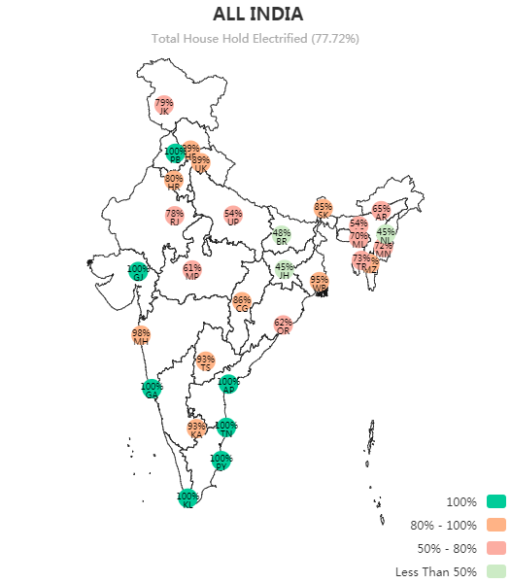
Rural electrification presents an additional business case for renewable energy
  Average supply across India is approximately 19.7 hours
Less than 78% of the households have access to electricity
Rural market largely remains untapped with 13% of the villages un-electrified
Significant latent demand exists even in electrified villages - current definition identifies an electrified village as one with even 10% of households electrified
Both availability and quality of supply need to be addressed
Opportunities of meeting such unmet demand with off-grid renewable energy should be explored
Households Electrified
Source: Grameen Vidyutikaran (GARV) portal
Notes:
Village electrification definition:
Transformers and feeders installed
Public institutions electrified
At least 10% households electrified

Slide 11
Financial implications of 24x7 supply are significant
Particulars | Value
Aggregate revenue of state owned Discoms in FY 15-16 in Rs crore | 4,24,948
Average national supply in hours | 19.7
Supply deficit in % - hours | 18%
Revenue implication of deficit in Rs crore | 76,137
Aggregate PAT on accrual basis of all state owned Discoms in FY 15-16 in Rs crore | (89,603)
Source: PFC and IMaCS estimates
Supply deficit of 18% (4.3 hours per day)
Based on broad calculations, it can be inferred that over 80% of losses can be mitigated with 24x7 supply
Notes:
Revenue implication of deficit has been calculated by assuming that entire country will be provided with 24 hours of supply
Calculations are broad – assumes that additional revenue will be supported proportionately by states via subsidy.
Comparison of additional revenue and PAT not entirely correct

Slide 12
Robust transmission and distribution infrastructure are imperative to support the growth
Significant leaps have been taken between 6th and 12th plans to augment the transmission network, which currently stands at 3,80,402 ckt.km.
T&D losses are projected to decline to 16.96% by FY 2021-22 from 20.65% currently (CEA)
Momentum of growth in transmission infrastructure and open access policy implementation needs to be continued to further facilitate inter-state power evacuation and optimum utilisation of available generation.
Government has undertaken several initiatives and schemes such as R-APDRP, IPDS, RGGVY, FRP, DDUGJY, UDAY, Saubhagya, etc to ensure sustainability of power sector.
Success of these initiatives largely depend upon improvement in operational efficiency of Discoms, which is yet to reach desired level
Source: UDAY Portal
Particulars | Status
Bond issuance under UDAY | Planned: Rs. 2.69 lakh crore; Issued till date: Rs. 2.32 lakh crore
AT&C loss | 24%
ACS-ARR gap | Rs. 0.28 per unit
Tariff Revision | Undertaken for 25 out of 27 states
Notes:
AT&C loss – Aggregate of Technical & Commercial Losses = Distribution (technical) loss + billing efficiency + collection efficiency
ACS – average cost of supply
ARR – average revenue realised
Key reasons of Discom stress – no direct control over tariff increase, continuously rising cost of supply, poor infrastructure and hence high losses. Even after UDAY, tariff revision not sufficient
R-APDRP - The Restructured Accelerated Power Development and Reforms Programme
IPDS - Integrated Power Development Scheme
RGGVY - Rajiv Gandhi Grameen Vidyutikaran Yojana
FRP – Financial Restructuring Plan
DDUGJY - Deen Dayal Upadhyaya Gram Jyoti Yojana
UDAY – Ujwal Discom Assurance Yojna
Saubhagya - Pradhan Mantri Sahaj Bijli Har Ghar Yojana

Slide 13
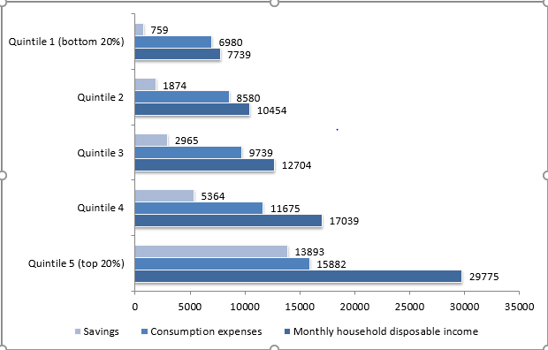
Efficiently designed tariffs ensure parity
  Incentives and subsidy element in tariff’s should be optimally designed so as to benefit economically weak consumers
  Presently, tariffs benefit economically better-off consumers also, for example MSEDCL has 67% LT residential consumers paying tariff 25% lower than ABR of category as a whole.
  The ICE 360 Consumer Survey shows more than 60% of India’s population have sufficient income for paying electricity bills and only 20% of the consumers (Quintile 1) require subsidy
  Due to this high element of cross-subsidy exists in Industrial & Commercial Consumers effecting their competitiveness.
  Cost of electricity forms a major portion of their cost of production in the power intensive industries. This leads to consumer migrating to alternate supply of power/open access/captive.
  Distorted tariff structure impacts appropriate cost recovery of distribution companies by way of cross-subsiding, making high end consumers move away from the discoms.
Source: ICE 360 Consumer economy Survey covering 60,000 households
Source: BEE & IMaCS Analysis

Slide 14
Timely completion of projects is necessary to meet growing demand
Thermal and Hydro projects prone to delays.
Government needs to provide for necessary facilitations to ensure timely completion of power projects
Though demand supply situation appears positive, delayed projects may lead to deficit.
S.N | Project Name | Developer | Capacity (MW) | Scheduled date | Actual/Anticipated
1 | Neyvelli New TPP | NLC | 1000 | FY 16 | FY 19
2 | IL&FS TPP | IL&FS | 1200 | FY 15 | FY 17
3 | Mutiara TPP | Coastal Energen | 1200 | FY 12 | FY 16
4 | Bongaigaon TPS | NTPC | 750 | FY 12 | FY 16
5 | Kanti TPS Stage II | NTPC & BSEB | 390 | FY 13 | FY 17
Source: Illustration Projects from CEA Broad Status Report

Slide 15
Enforceability of contracts is paramount to garner investor confidence
Successful solar and wind bids have discovered tariffs significantly lower than existing feed-in tariffs.
(Solar @ Rs. 2.44, Wind @ 2.64)
While low tariffs are favourable for Discoms, maintaining investor confidence is paramount for the sustainability of the sector
    Tamil Nadu had cancelled award of 500 MW solar projects stating high tariff @ Rs 4.40 per unit.
    Uttar Pradesh had cancelled PPAs with thermal plants citing high tariffs
    Karnataka Discoms had dishonoured wind PPAs citing change of regulations
    Andhra Pradesh’s Discoms approached the state regulator to change the terms of PPAs for wind projects.
  Solar curtailment has increased significantly. Availability of cheaper short term power appears to be a probable reason.
Notes:
Feed-in tariffs: these are preferential tariffs given to renewable energy projects to promote them
Curtailment increase – because PPAs were signed at high rates + discom not willing to honor commitments + cheaper power available now

Slide 16
Electric vehicles have the potential to increase the electricity demand many-folds
GoI plans to make India 100% electric vehicles nation by 2030, current market share - 0.02%
Investments need to be made in developing charging infrastructure to make India an attractive proposition for investors.
Developments in EV market will also open the market for battery manufacturing
Environmental benefits of electric vehicles will be immense
Investments in EV will harness significant benefits for the power sector
  Off-grid renewable energy can be used for charging, without impacting the grid
  Reduction in storage requirements
  May help in reducing AT&C losses on account of addition of assured sources of revenue

Slide 17
Thank you
For any clarifications on this presentation, please contact:
Sanjeev Sinha, CEO & MD, IMaCS and Head Non Rating Business, ICRA
sanjeev.sinha@imacs.in
Rachit Verma, Principal – Business Development, IMaCS
rachit.verma@imacs.in

Slide 18
Disclaimer
All information contained in this document has been obtained by IMaCS from public sources and believed to be accurate and reliable. Although reasonable care has been taken to ensure that the information herein is true, such information is provided ‘as is’ without any warranty of any kind, and IMaCS in particular, makes no representation or warranty, express or implied, as to the accuracy, timeliness or completeness of any such information. All information contained herein must be construed solely as statements of opinion, and IMaCS shall not be liable for any losses incurred by users from any use of this document or its contents in any manner. Opinions expressed in this document are not the opinions of our holding company, ICRA Limited (ICRA), and should not be construed as any indication of credit rating or grading of ICRA for any instruments that have been issued or are to be issued by any entity.

